Slide 1
Chiral nuclear forces and ab initio calculations of nuclear structure
Furong Xu (许甫荣)
Chiral EFT nuclear forces
The first-principles (ab initio) calculations of nuclear structure
Conclusions and perspectives
The 8th IOPP Colloquium, March 17, 2026, Central China Normal University, Wuhan

Slide 2
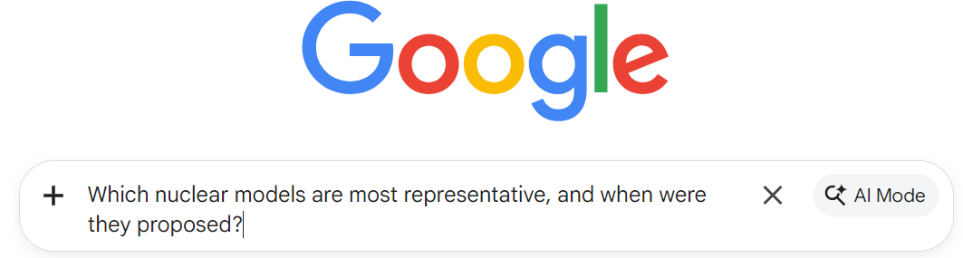
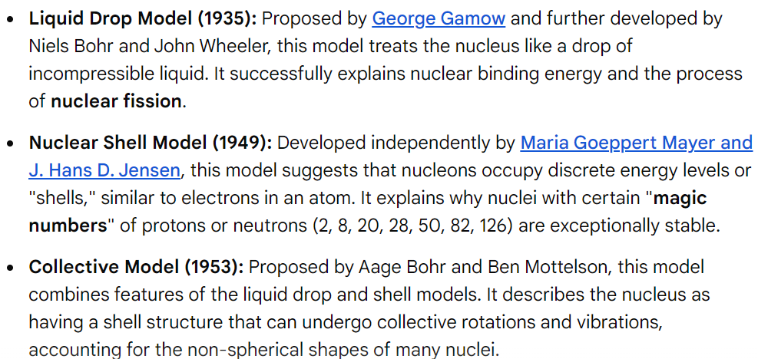
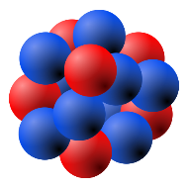
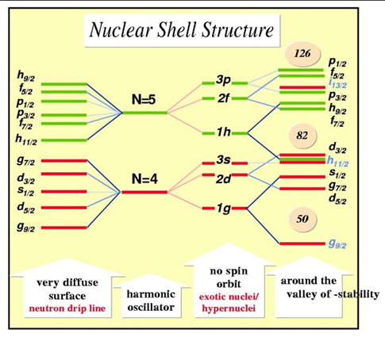
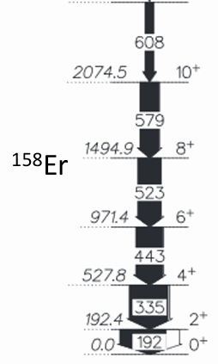
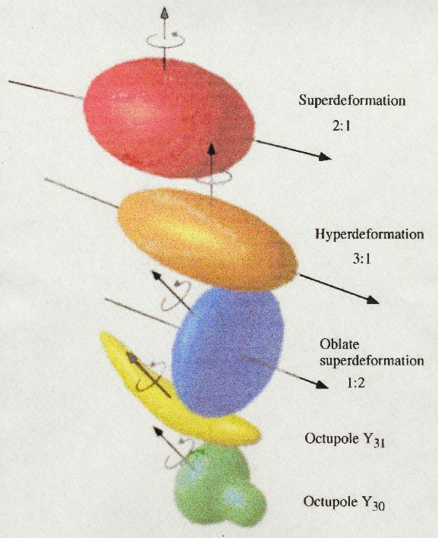

1963 Nobel Prize
1975 Nobel Prize
for the discovery of the connection between collective motion and particle motion in atomic nuclei and the development of the theory of the structure of the atomic nucleus based on this connection

Slide 3


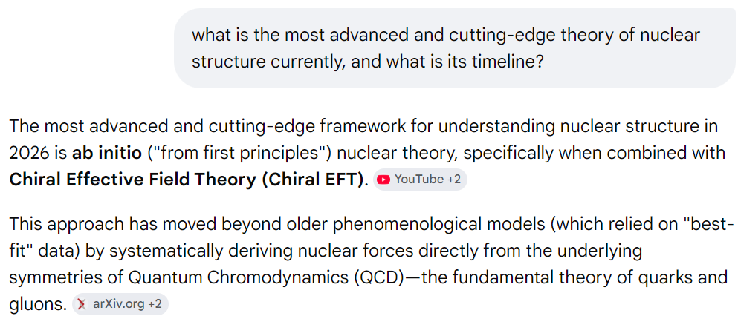
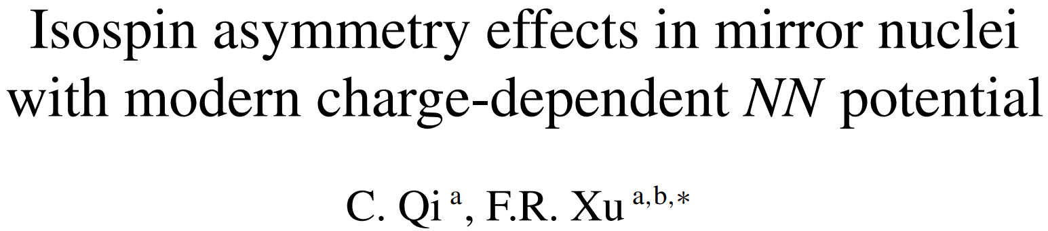
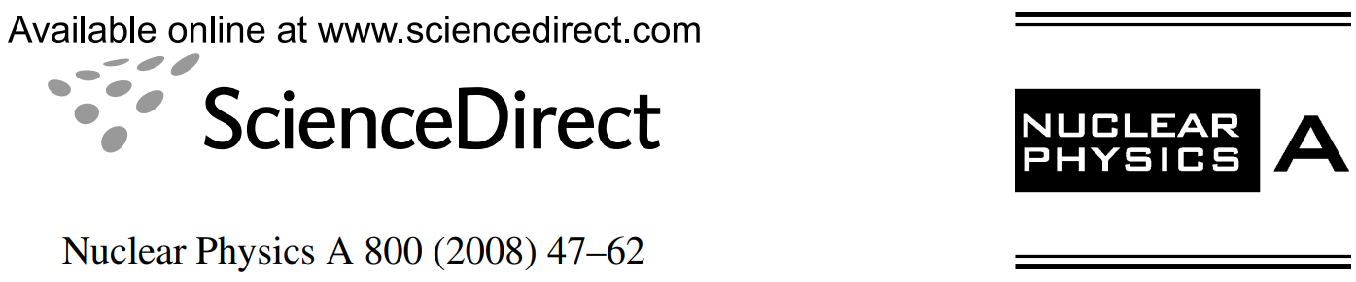
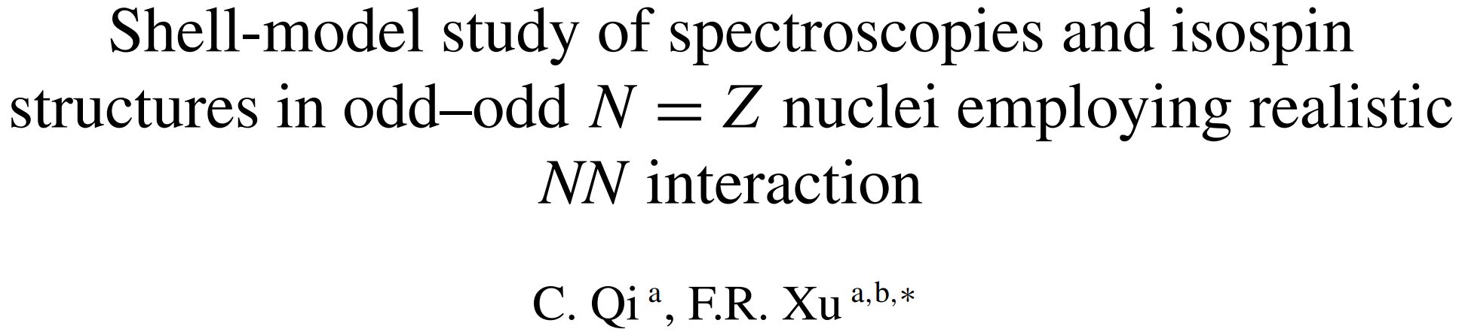
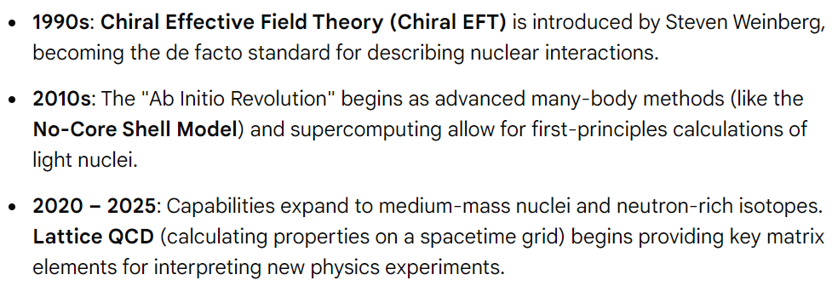
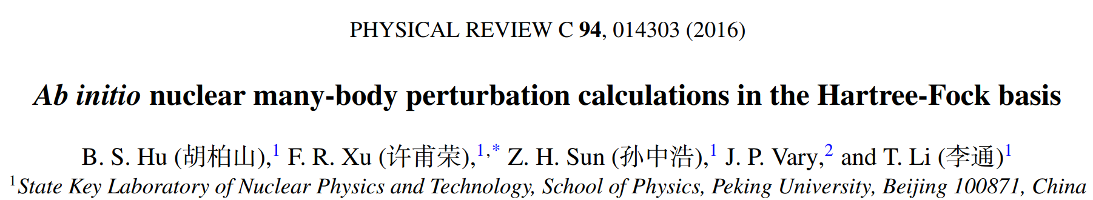
2000s: The early stage

Slide 4
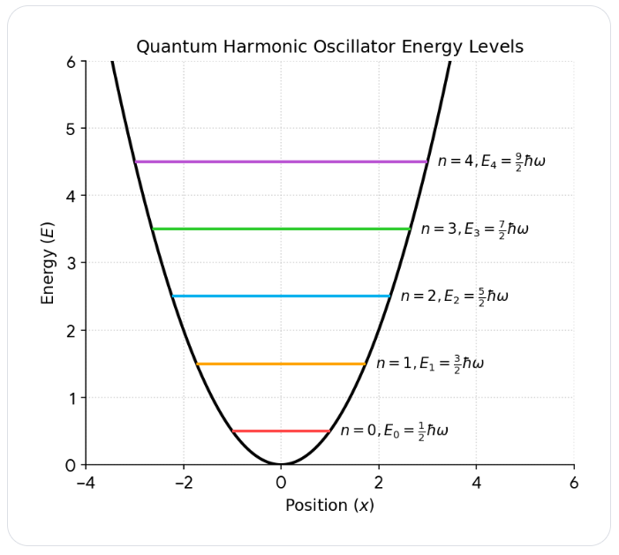
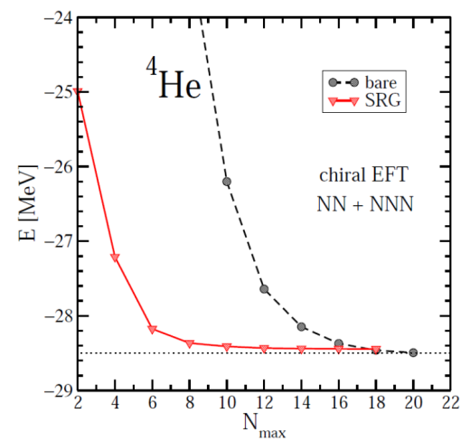
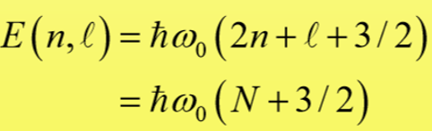
Ab initio 核结构序论
核结构理论的二个最基本问题
Nuclear force（核力）
Many-body correlations（多体量子关联）
什么叫核结构（核物理）第一性原理计算 (ab initio, first principles) ？
1）Start from realistic nuclear forces
2) Rigorously treat many-body correlations (数值计算收敛或可控)
No-core shell model (NCSM)

Slide 5
Three steps of ab initio calculation of nuclear structure (计算三步曲)
Realistic nuclear forces:
Chiral EFT, CD Bonn, AV18 …
Renormalization to soften the force, to speed up convergence
SRG, UCOM, V_{low-k ,} OLS, (G-Matrix) …
Ab-initio many-body methods
No Core Shell Model (NCSM)
Coupled Cluster (CC)
In-medium Similarity Renormalization Group (IMSRG)
Configuration interaction shell model
Self-consistent Green’s Function
Diffusion Monte Carlo
Lattice Nuclear Chiral EFT
Many-Body Perturbation Theory (MBPT)
(Dirac-) Bruckner-Hartree-Fock (only for ground states)

Slide 6
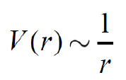
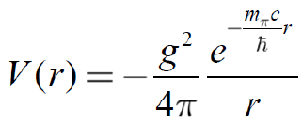
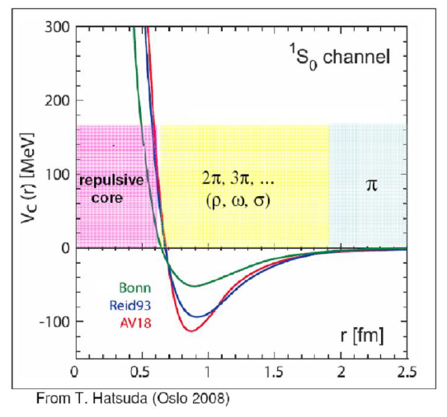

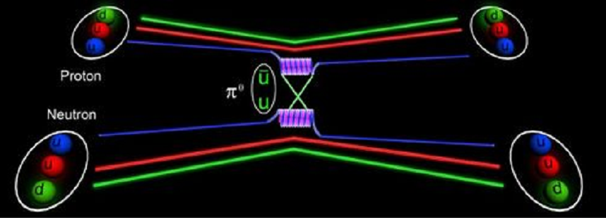
I. Realistic nuclear forces
Electromagnetic force has an infinite range!
(交换光子，m_{γ}=0)
Yukawa nuclear force by π meson exchange
交换π介子
Long-range attractive，no short-range repulsive

Slide 7

History, Phase I (The first pion period)
Chadwick (1932): Neutron
Heisenberg (1932): First Phenomenology (Isospin)
Yukawa (1935): Meson Hypothesis
1930’s
Discovery of the pion in cosmic ray (1947) and in the
Berkeley Cyclotron Lab (1948).
Nobelprize awarded to Yukawa (1949).
1940’s
Taketani, Nakamura, Sasaki (1951): 3 ranges.
One-Pion-Exchange (OPE): o.k.
Multi-pion exchanges: Problems!
Taketani, Machida, Onuma (1952);
Brueckner, Watson (1953).
1950’s
“Pion Theories”

Slide 8
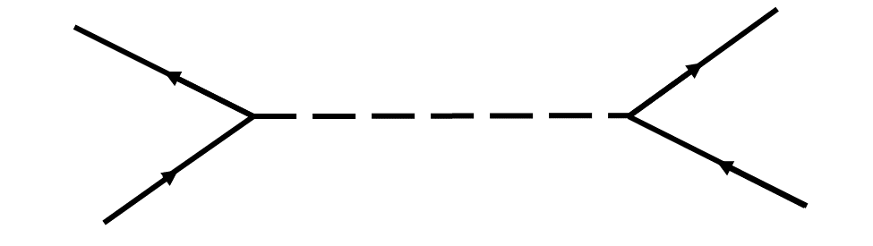
Phase II: The meson period
Many pions = multi-pion resonances:
One-Boson-Exchange Model
1960’s
Refined Meson Theories
Paris Potential (Lacombe et al., PRC 21, 861 (1980))
Bonn potential (Machleidt et al., Phys. Rep. 149, 1 (1987))
1970’s

Slide 9
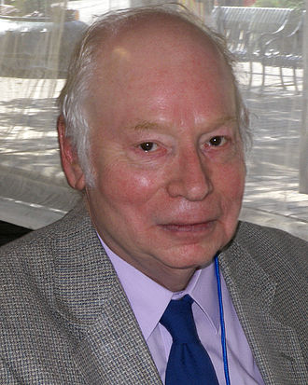
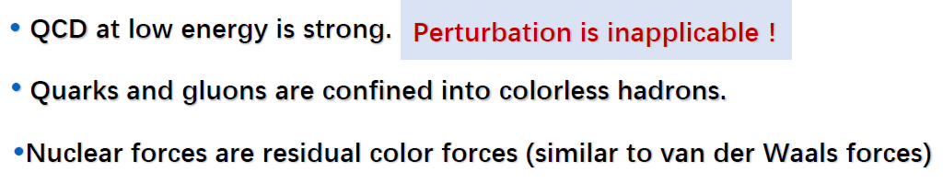
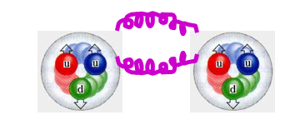
Phase III: The QCD/EFT period
Nuclear physicists discover QCD:
Quark cluster models.
1970’s-1980’s
QCD = quarks + gluons (symmetries: spin, isospin, parity, chiral symmetry broken spontaneously)
Effective Field Theory (EFT): Weinberg
Another “pion theory”; constrained by chiral symmetry
1990’s – today
Chiral EFT = nucleon + pion (symmetries: spin, isospin, parity, chiral symmetry broken spontaneously)
At low energy, the effective degrees of freedom are nucleon and pion, rather than quark and gluon !
Residual force of the QCD strong interaction outside the nucleon

Slide 10
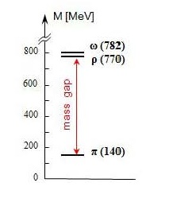
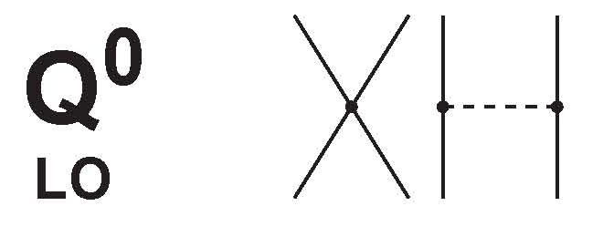
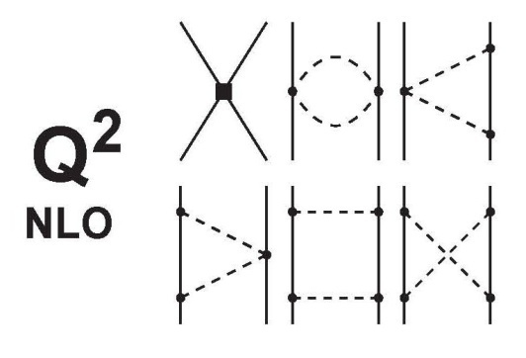

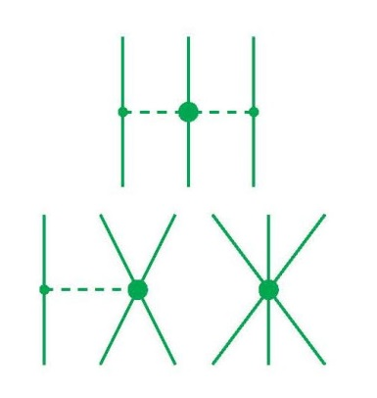
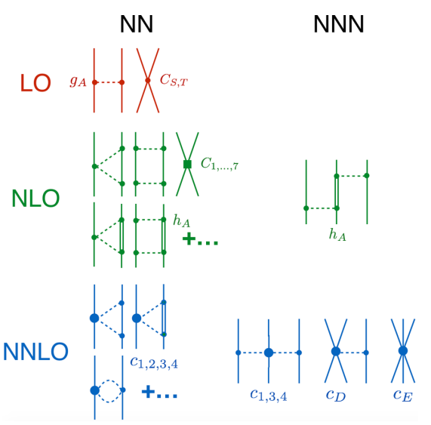
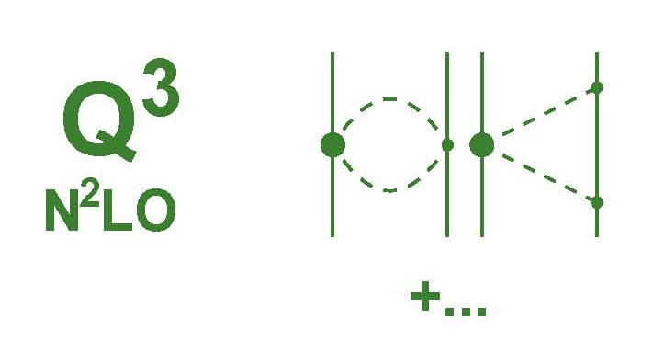
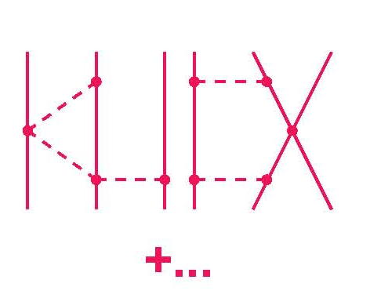
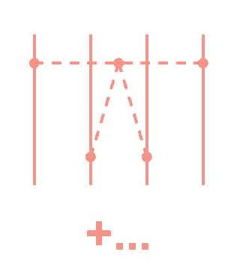
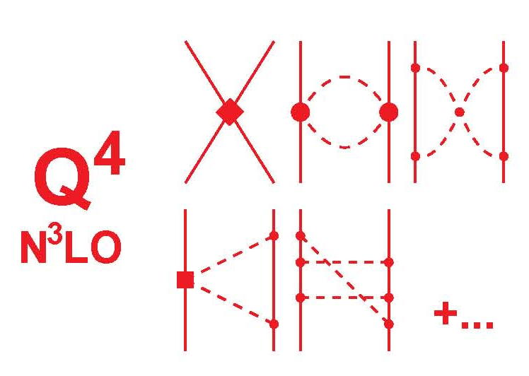
2N forces
3N forces
4N forces
Leading Order
Advantages:
Gives hierarchy of nuclear force
Naturally generates 3NF, 4NF…
Control the uncertainty of each hierarchy
Chiral EFT
2000年以后才开始EFT核物理计算
Next-to Leading Order
Power counting ：
Next-to-Next-to Leading Order
Next-to-Next-to-Next-to Leading Order
10

Slide 11
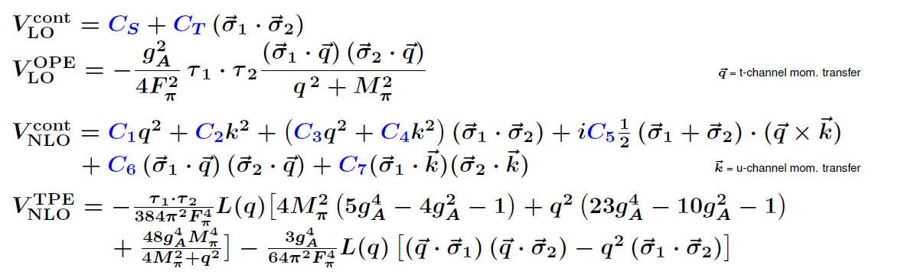
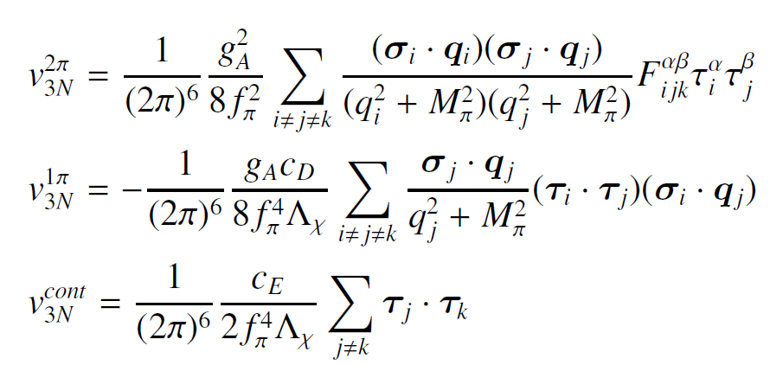
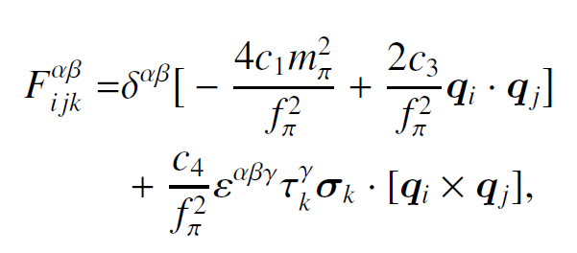
2NF
3NF

Slide 12

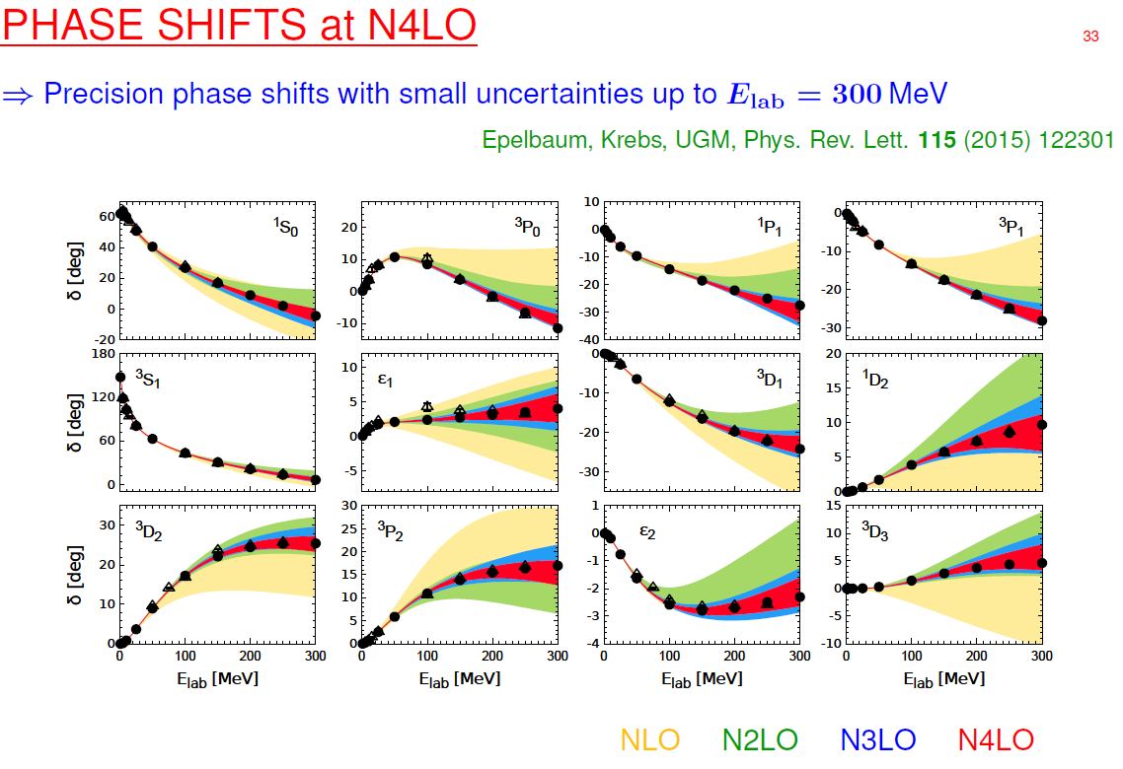
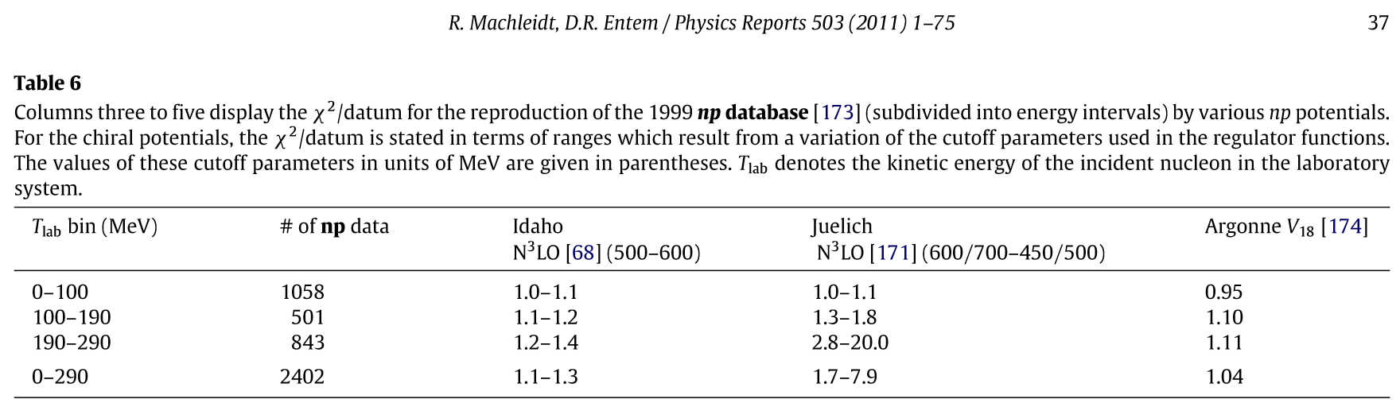
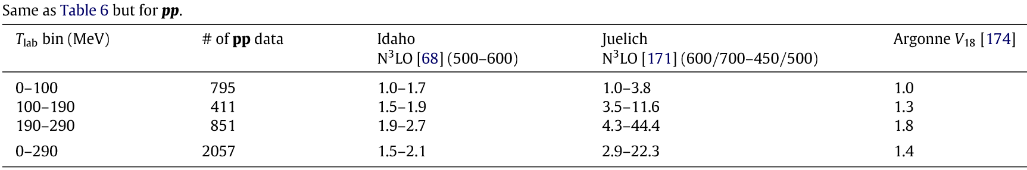
High-precision EFT nuclear forces
(about 6000 NN Data below 350 MeV)
核力势参数由nucleon-nucleon散射(and ²H)数据确定，不使用核结构实验数据！ab initio (realistic) force

Slide 13
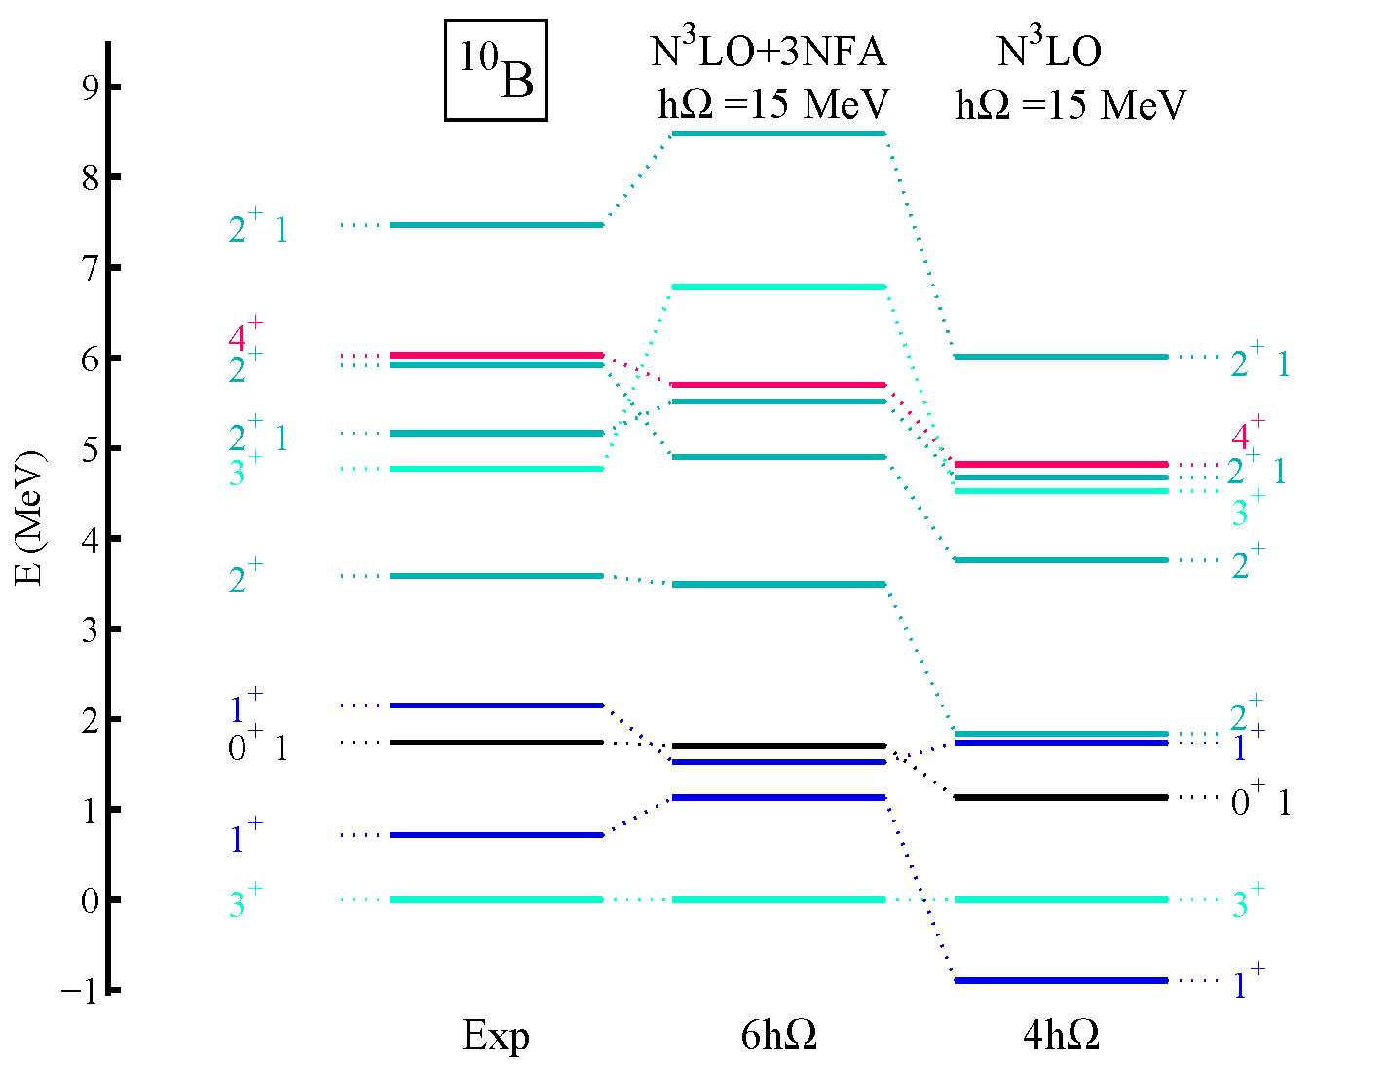
Calculating the properties of light nuclei using chiral 2N and 3N forces
NCSM calculation by P. Navratil et al.
2N (N3LO) +3N (N2LO)
2N (N3LO) only
Notes:
boron

Slide 14

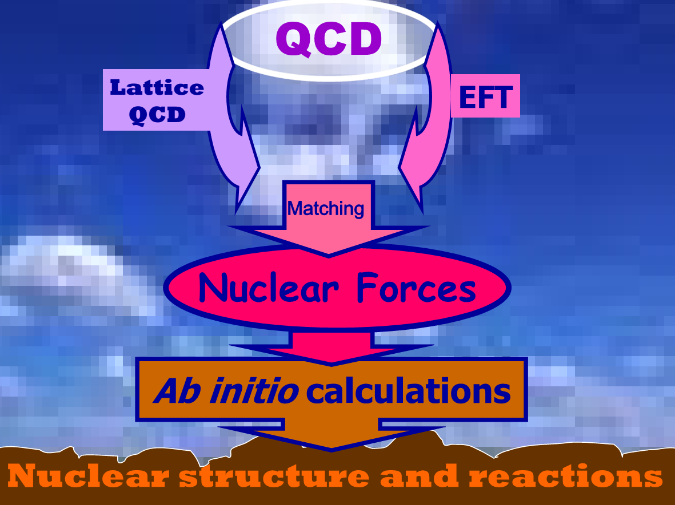
After 80 years of struggle （from 1950s), we have now a proper theory (Chiral EFT) for nuclear force that is based upon the fundamental theory of strong interactions, QCD.
Machleidt

Slide 15
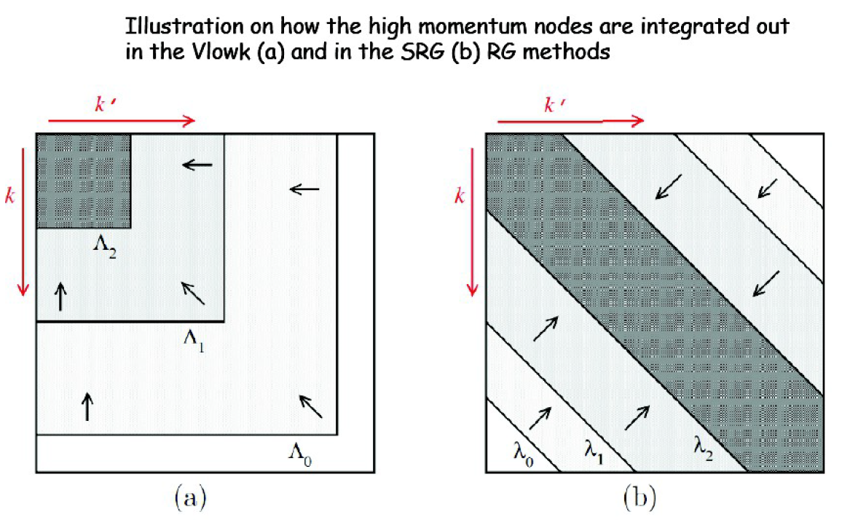
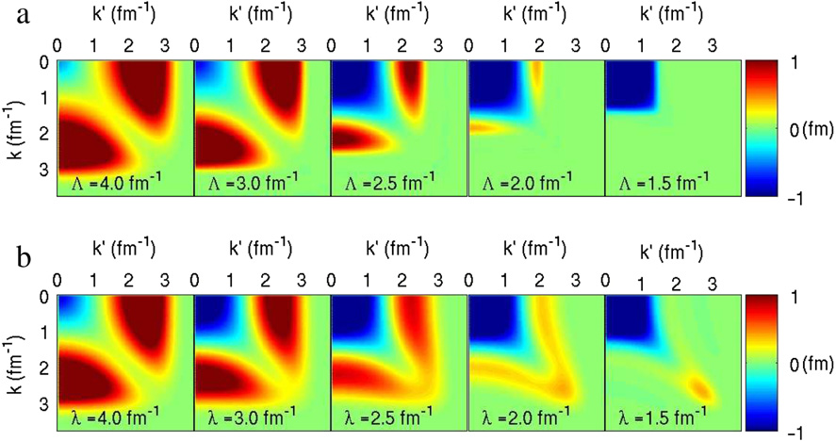
II. Renormalizations
i) Softening to speed up convergence of many-body calculation: SRG, V_{low-k} , UCOM, OLS, …
ii) Decoupling for a valence space: MBPT (S-, Q-Box) , VS-IMSRG…
软化核力
V_{low-k}
SRG
V_{low-k}
SRG

Slide 16
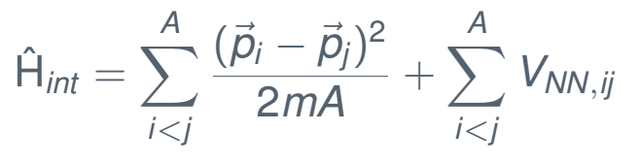
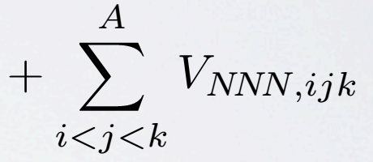
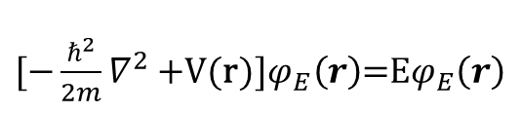
III. Rigorous ab initio many-body methods (如何“严格”求解强关联量子多体体系？)
$[−\frac{ℏ^{2}}{2m}∇^{2}+$V(r)]$φ_{E}\left(r\right)$=E$φ_{E}\left(r\right)$
No Core Shell Model (NCSM)
Coupled Cluster (CC)
In-medium Similarity Renormalization Group (IMSRG)
Configuration interaction shell model
Selfconsistent Green’s Function
Diffusion Monte Carlo
Lattice Nuclear Chiral EFT
Many-Body Perturbation Theory (MBPT)
(Dirac-) Bruckner-Hartree-Fock (基态）

Slide 17
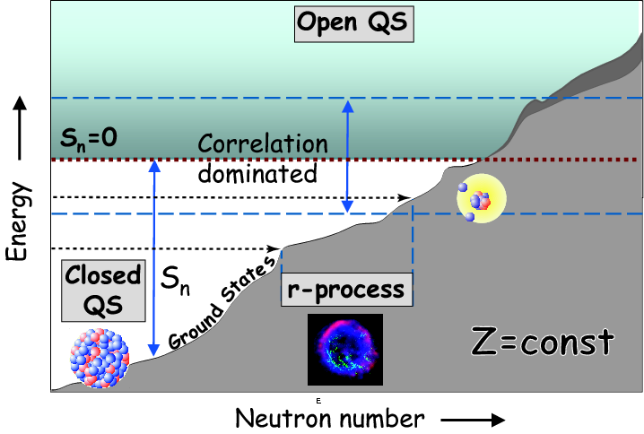
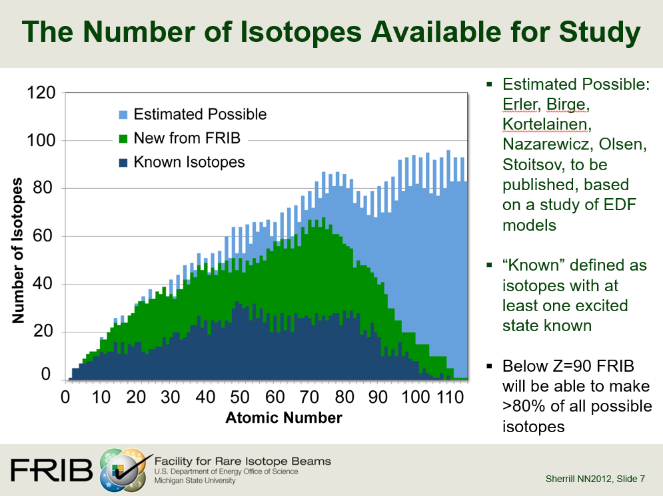
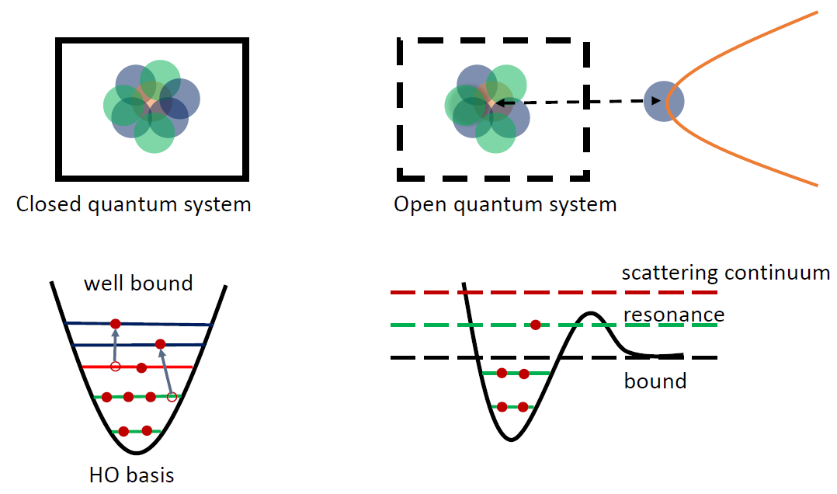


我们组的工作：complex-energy ab initio calculations for nuclei around driplines as OQS
Coupling to the continuum “environment”
Time-dependent problem
核天体物理 Element production：不稳定原子核扮演重要角色角色

Slide 18

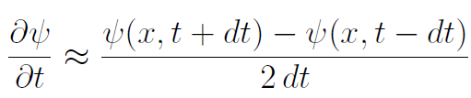
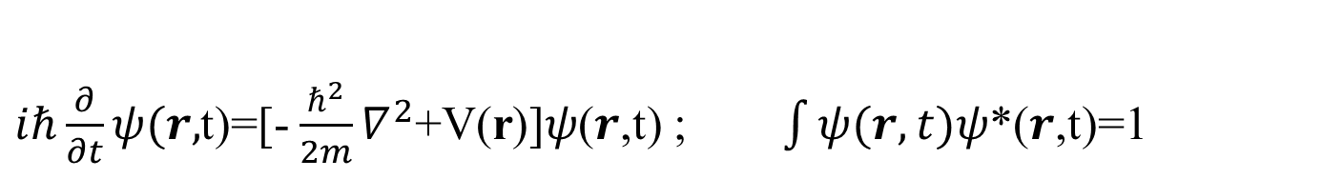

Time-dependent Schrodinger equation (TDSE)
$i\text{ℏ}\frac{∂}{∂t}ψ(r,$t)=[- $\frac{ℏ^{2}}{2m}∇^{2}$+V(r)]𝜓(𝒓,t) ; $\int{ψ(r,t)}$𝜓*(𝒓,t)=1
Exact solution is impossible!
Computation by discretizing the TDSE:
不友好的数值计算方法
核结构计算喜欢：Stationary
$ψ(r,t)$=$e^{−iEt/ℏ}φ_{E}\left(r\right)$
$[−\frac{ℏ^{2}}{2m}∇^{2}+$V(r)]$φ_{E}\left(r\right)$=E$φ_{E}\left(r\right)$
但是， Stationary方法不能描述：非束缚共振态、连续谱影响、nucleon emissions …

Slide 19




Time-dependent problem can be approached by time-independent complex-energy quasi-stationary
One-body Berggren (Gamow) basis
$ψ(r,t)$=$e^{−iEt/ℏ}φ_{E}\left(r\right)$ $[−\frac{ℏ^{2}}{2m}∇^{2}+$V]$φ_{E}\left(r\right)$=E$φ_{E}\left(r\right)$ But E can be complex, and the inner product: $\int{φ_{E}\left(r\right)φ_{E}\left(r\right)}$=1 (not the complex conjugate) 1) E is a negative real number: bound 2) E is a positive real number: continuum 3) $E=\frac{ℏ^{2}k^{2}}{2m}$=$E_{R}−i\frac{Γ}{2}$ : resonance $ψ(r,t)$=$e^{−iEt/ℏ}φ_{E}\left(r\right)$=${e^{−iE_{n}t/ℏ}φ}_{E}\left(r\right)e^{−Γℏt/2}$
T. Berggren, NPA109 (1968) 265

Slide 20




我们组在ab initio 领域的贡献: complex-energy ab initio methods with resonance and continuum
1）Nuclear forces
Chiral 3NF → complex-energy space
Chiral 2NF → complex-energy space
2） Renormalization
Complex S-, Q-, Θ-box → ab initio valence-space effective operators
3) Ab initio many-Body methods with resonance and continuum
a) Complex-energy Gamow shell model
b) Complex-energy Gamow IMSRG
c) Full configuration-interaction quantum Monte Carlo (FCIQMC) (2010 proposed) (我们目前还在real-energy)
Hermitian
Non-Hermitian
Complex symmetric

Slide 21










Complex-energy Berggren basis: bound, resonance and continuum
Non-integrable
complex scaling:
，
J. Aguilar and J. M. Combes, Comm. Math. Phys. 22, 269 (1971)；
E. Balslev and J. M. Combes, Comm. Math. Phys. 22, 280 (1971)
$${ε=e}_{n}−\frac{iΓ_{n}}{2}$$
$ψ_{n}(r,t)$=${e^{−ie_{n}t/ℏ}φ}_{n}\left(r\right)e^{−Γ_{n}t/2ℏ}$

Slide 22







Berggren presentations only provides a basis, we treat many-body problem using this basis
Ab initio many-body problem: converged!
Ab initio many-body perturbation theory (MBPT) to construct a model-space effective interaction
Complex Q-box
Folded diagrams
Iteration to include infinite-order folded diagrams

Slide 23






Complex-energy Gamow shell model calculations
The mirror nucleus ⁶Be of ⁶He
0⁺
⁶He halo
g.s.: narrow resonance
2+: broad resonance
Notes:
FHT: Furutani-Horiuchi-Tamagaki

Slide 24












给出四中子态的最好理论预言，脆弱系统可以灵敏检验核力
北大理论预言
Nature 606, 678 (2022)
最新实验
北大理论预言
… …
其他国际理论预言

Slide 25











²⁸O
其他理论预言
理论预言与实验数据均存在1.0 MeV以上的差别
1) Li, Michel, Zuo, Xu, PRC 103, 034305 (2021)
2) Zhang, Ma, Li, Hu, Yuan, Cheng, Xu, PLB 827, 136958 (2022)
北大理论预言
实验
其他理论预言
News & views comments：²⁸O实验结果对所有的理论预言提出严峻挑战。
含连续谱的ab initio计算能精确预言²⁸O能量

Slide 26

²⁸O relative to ²⁴O
Without continuum
With continuum
Y. Kondo et al., Nature 620, 965 (2023)
S. Zhang, Y.Z. Ma, J.G. Li, B.S. Hu, Q. Yuan, Z.H. Cheng, FRX, PLB 827, 136958 (2022)

Slide 27


3NF的重要性
M. Wang, Y.H. Zhang,…, FRX,… PRL 130, 192501 (2023)
3NF explains the form mechanism of the 19/2 – isomer in ⁵³Co and ⁵³Fe mirrors
The first proton emission discovered is from the isomer in ⁵³Co in 1970
3NF enhances T=1 pn pairing over the T = 0 pn pairing in this mass region, leading to the opposite trends of δV_{pn} in even-even and odd-odd nuclei.
从根那里，给出真实的物理机制！
In N=Z, odd proton and odd neutron can couple to isospin T = 1 with J = 0, 2, …, 2j − 1, or to T = 0 with J = 1, 3, …, 2j. In this region, o-o nuclei g.s. (J^{π} ,T)=(0⁺, 1 ) exp.
Yuan, Hu, Xu, Li, FRX, Walker, PRC 111, 034309 (2025)

Slide 28

Our new chiral 3NF gives the best description in both energies and radii
R. Z. Hu, J. G. Li , S. Q. Fan, and F. R. Xu (submitted)

Slide 29


Conclusions
基本对称性精确测量 (粒子物理交叉)
Now, ab initio theory can provide precise calculations. Thanks to advance of supercomputer.
Tell the true story
3) Better determine the LECs of EFT nuclear forces
including 3NF c_{D} and c_{E}. Possible from QCD?
4) Less truncations, and move to heavier mass regions
5) Unified description of nuclear structure and reactions
6) Many-body currents in weak processes
7) More powerful many-body methods with higher-order
many-body correlations
……
Perspectives

Slide 30







世界上新建、在建、拟建放射性核大装置
中国
CSR 2008
MSU-NSCL
美国FRIB
中国BRIF 2014
CIAE
HIRFL
CSR
Texas A&M
惠州HIAF
韩国
日本RIBF
法国SPIRAL-II 2
德国FAIR
30

Slide 31

Many thanks to 华师同事、同学！
The 8th IOPP Colloquium, March 17, 2026, CCNU, Wuhan
团队：胡柏山，李健国, 孙中浩，吴强，马远卓，张爽，袁琪，许志成，金少亮，胡荣哲，徐馨宇，裴俊琛…
N. Michel, W. Zuo, L. Coraggio, T. Fukui, N. Itaco, A. Gargano

