Slide 1




Physics Colloquium, Thursday, May 7, 2026
Nuclear Fission as Brownian motion
Jørgen Randrup
Lawrence Berkeley National Laboratory

Slide 2
Physics Colloquium, Thursday, May 7, 2026
Nuclear Fission as Brownian motion
Quantum many-body dynamics made tractable
Jørgen Randrup
Lawrence Berkeley National Laboratory

Slide 3
Nuclear fission
Nuclear fission provides a unique testing ground for treatments
of quantum many-body dynamics
Fission research has experienced a renaissance over the past
several years and many young people are entering the field
Significant improvements in instrumentation have led to better
and more complex experimental data
Ever more powerful computational resources have made it
possible to develop more detailed theoretical descriptions
A true theory of nuclear fission is still (far?) in the future, so
simplified and tractable treatments are required meanwhile
In addition to its inherent interest, nuclear fission plays important
roles in other areas of basic research:
Fission terminates the r-process causing fission recycling, and the
fragment yields influence the elemental abundances in the universe
The weak decays of the fission products play a crucial role
in studies of reactor anti-neutrinos (e.g. Daya Bay and Juno)

Slide 4
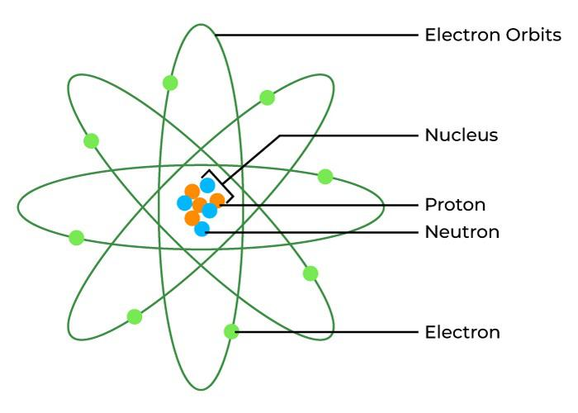
Atomic nucleus
A = Z + N nucleons
(Z)
(N)

Slide 5
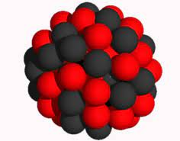
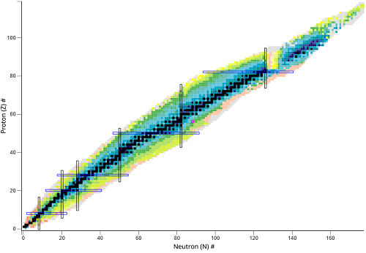
Chart of Nuclei
100
²⁰⁸Pb
A = Z + N
Protons Z
50
¹³²Sn
⁴⁰Ca
50
100
150
Neutrons N

Slide 6
Chart of Nuclei
²³⁶U
100
A = Z + N
Protons Z
Heavy
50
Light fragment
50
100
150
Neutrons N

Slide 7
Nuclear fission
has many stages
Illustration by Pierre Morfouace

Slide 8
Nuclear dynamics
How does a nuclear system evolve?
Particular challenge: Many very different evolutions are possible:

Slide 9
Nuclear physics refresher: Basic properties
Macroscopic features
Microscopic features
Z protons
N neutrons
A nucleons
G. Gamow 1930, C.F. von Weizsäcker 1935:
A nucleus resembles a (uniformly) charged
(incompressible) deformable liquid drop
=> A nuclear system has a
SHAPE
Many-body dynamics
-> Shape dynamics

Slide 10
Nuclear physics refresher: Basic properties
Macroscopic features
Microscopic features
Z protons
N neutrons
A nucleons
G. Gamow 1930, C.F. von Weizsäcker 1935:
A nucleus resembles a (uniformly) charged
(incompressible) deformable liquid drop
E_{macro}(Z,N;shape) ≈ E_{bulk} + E_{surf} + E_{Coul}
E_{macro}

Slide 11

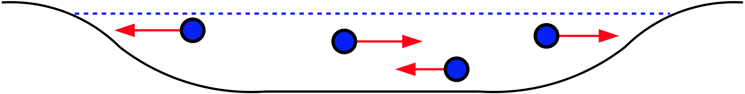
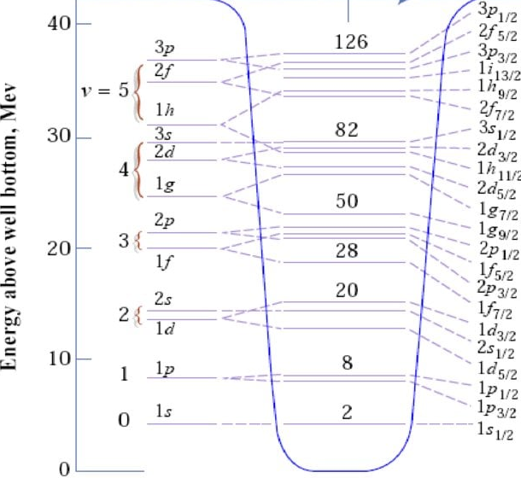
Nuclear physics refresher: Basic properties
Macroscopic features
Microscopic features
Nucleons are fermions
=> scattering is Pauli suppressed
=> mean free path is long
=> single-particle orbitals
Z protons
N neutrons
A nucleons
G. Gamow 1930, C.F. von Weizsäcker 1935:
Nucleons move in a common mean field
A nucleus resembles a (uniformly) charged
(incompressible) deformable liquid drop:
Single-particle energy levels
E_{macro}(Z,N;shape) ≈ E_{bulk} + E_{surf} + E_{Coul}
E_{macro}

Slide 12
Shape-dependent nuclear binding energy
can be calculated fairly reliably
Macroscopic features
Microscopic features
Nucleons are fermions
=> scattering is Pauli suppressed
=> mean free path is long
=> single-particle orbitals
Z protons
N neutrons
A nucleons
G. Gamow 1930, C.F. von Weizsäcker 1935:
A nucleus resembles a (uniformly) charged
(incompressible) deformable liquid drop:
E_{macro}(Z,N;shape) ≈ E_{bulk} + E_{surf} + E_{Coul}
δ E = Σ_{ν} f_{ν} δ ε_{ν}
Fermi level
E_{macro}
Single-particle level spectra

Slide 13
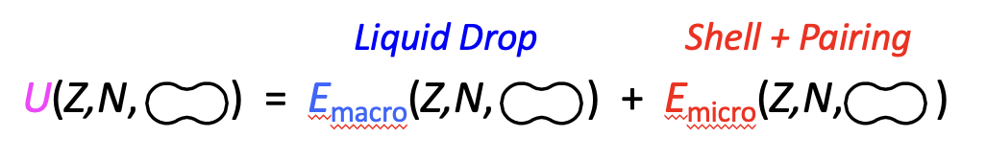
Shape-dependent nuclear binding energy
can be calculated fairly reliably
Macroscopic features
Microscopic features
Nucleons are fermions
=> scattering is Pauli suppressed
=> mean free path is long
=> single-particle orbitals
Z protons
N neutrons
A nucleons
G. Gamow 1930, C.F. von Weizsäcker 1935:
A nucleus resembles a (uniformly) charged
(incompressible) deformable liquid drop:
E_{macro}(Z,N;shape) ≈ E_{bulk} + E_{surf} + E_{Coul}
E_{total}
smooth undulates
E_{macro}

Slide 14
Shape-dependent nuclear binding energy
can be calculated fairly reliably
Macroscopic features
Microscopic features
Nucleons are fermions
=> scattering is Pauli suppressed
=> mean free path is long
=> single-particle orbitals
Z protons
N neutrons
A nucleons
G. Gamow 1930, C.F. von Weizsäcker 1935:
A nucleus resembles a (uniformly) charged
(incompressible) deformable liquid drop:
E_{macro}(Z,N;shape) ≈ E_{bulk} + E_{surf} + E_{Coul}
E_{total}
smooth undulates
E_{total}
E_{macro}
E_{macro}

Slide 15
Fission shape dynamics requires at least FIVE shape parameters:
²³⁶U

Slide 16
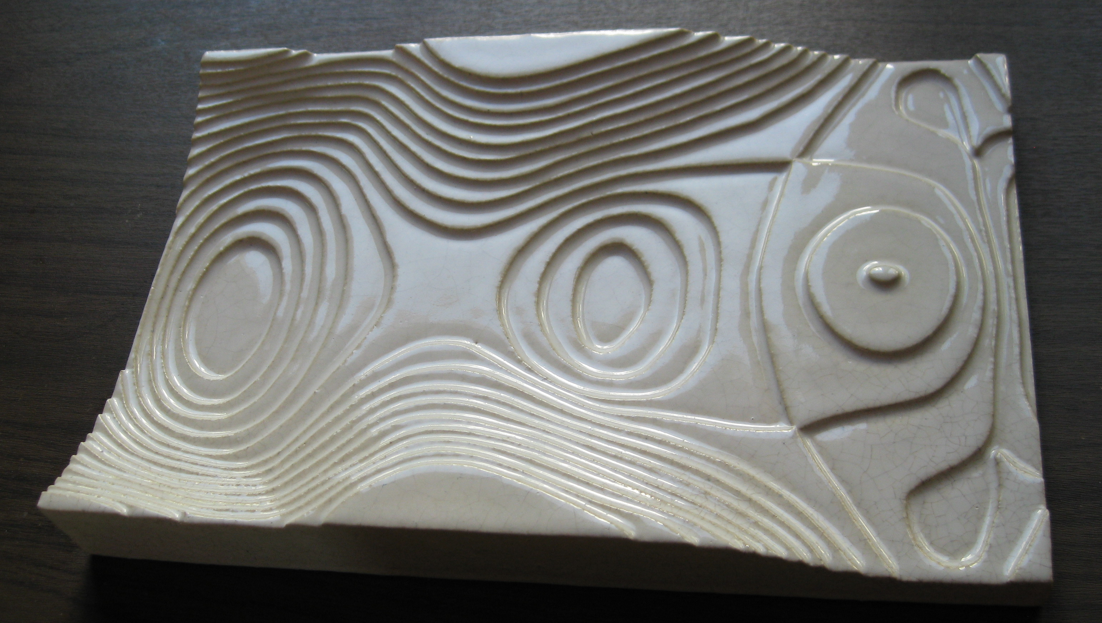
Fission shape dynamics requires at least five shape parameters
=> Five-dimensional potential energy surface U(q) = U(Q₂, α, c, ε_{f1}, ε_{f2})
U(q) reduced to
one dimension
(elongation)
Based on calculations by Peter Möller (1970)
¹³²Sn
U(q) reduced to
two dimensions
(elongation and
mass asymmetry)
Asymmetry α
¹³²Sn
Elongation Q₂
²³⁶U

Slide 17
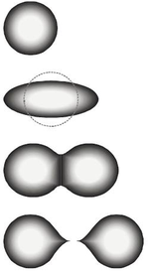

Nuclear shape dynamics: Formal framework
Lagrangian:
Momentum:
Conservative
motion (γ = 0):
Conservative
dynamics:
Conservative force:
F^{cons} = F^{mass} + F^{pot}
The macroscopic (shape) degrees of freedom are not isolated:
they are coupled to the microscopic (internal) degrees of freedom
Dissipative force:
F^{diss} = F^{fric} + F^{ran}
Friction force:
Random force:
Dissipative
dynamics:
Langevin
equation
Need U(q) & M_{ij}(q) & γ_{ij}(q)!
1 + 15 + 15

Slide 18
Nuclear shape dynamics: Formal framework
Lagrangian:
Momentum:
Conservative
motion (γ = 0):
Conservative
dynamics:
Conservative force:
F^{cons} = F^{mass} + F^{pot}
The macroscopic (shape) degrees of freedom are not isolated:
they are coupled to the microscopic (internal) degrees of freedom:
Dissipative force:
F^{diss} = F^{fric} + F^{ran}
Friction force:
Random force:
Dissipative
dynamics:
Langevin
equation
Need U(q) & M_{ij}(q) & γ_{ij}(q)!
1 + 15 + 15

Slide 19

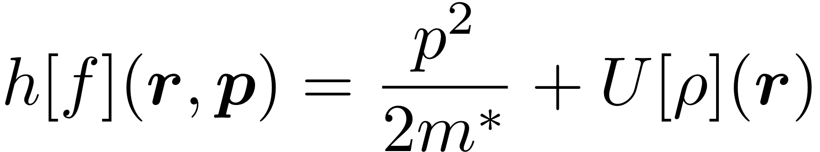
Nuclear shape dynamics: Formal framework
Lagrangian:
Momentum:
Conservative
motion (γ = 0):
Conservative
dynamics:
Conservative force:
F^{cons} = F^{mass} + F^{pot}
The macroscopic (shape) degrees of freedom are not isolated:
they are coupled to the microscopic (internal) degrees of freedom
Nuclear one-body dissipation
Dissipative force:
F^{diss} = F^{fric} + F^{ran}
Friction force:
Single-particle Hamiltonian
Nucleons in a deforming mean field
Random force:
Shape evolves => field changes => nucleons are agitated
Dissipative
dynamics:
Langevin
equation
Need U(q) & M_{ij}(q) & γ_{ij}(q)!
This gives rise to a dissipative force on the shape motion
The shape change
heats the nucleus
1 + 15 + 15
J Blocki, Y Boneh, JR Nix, J Randrup, M Robel, AJ Sierk, WJ Swiatecki, Ann. Phys. 113, 330 (1978)

Slide 20
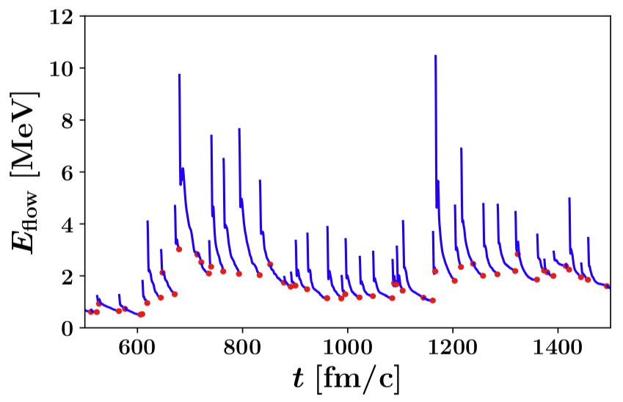
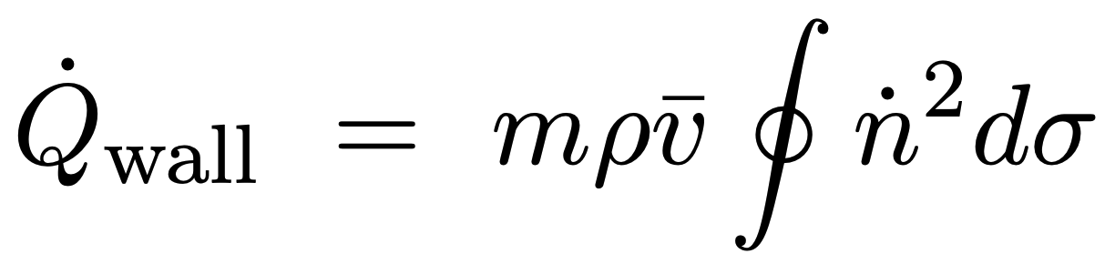
One-body dissipation
is STRONG!
(overdamped shape motion)
Macroscopic/Classical:
Microscopic/Quantal:
J. Blocki et al. (1978)
A. Bulgac et al. (2018)
TDDFT
Wall formula
Time-Dependent Density Functional Theory
t_{damp} ≈ 20 - 40 fm/c
SAME
t_{damp} ≈ “several tens” of fm/c

Slide 21

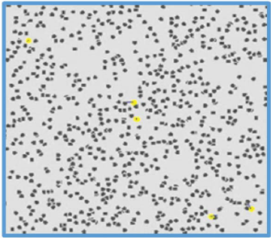
The shape motion is overdamped
=> The evolution is akin to Brownian motion
A heavy body immersed in a fluid of light constituents
receives impulses at random times and in random directions,
leading to a diffusive trajectory with a negligible kinetic energy
Standard Brownian motion:
3 dimensions: r = (x,y,z)
uniform in space
isotropic in direction
no external force: U(r)=0
Generalized Brownian motion:
N dimensions: N shape parameters q = (q₁,…,q_{N} )
non-uniform: the coupling depends on the shape q
anisotropic: each shape parameter reacts differently
external force: from the deformation energy U(q)

Slide 22
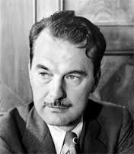
Brownian shape motion can be simulated as a
random walk on the potential-energy surface U(q):
ρ(q): density of states at the shape q
Fermi gas ρ_{FG}(q)
KEY QUANTITY:
Microscopic ρ_{micro}(q)
“Uphill”: maybe
“Downhill”: always
?
?
U
U
Detailed
balance
✓
q -> q’
q -> q’
ρ(q’) < ρ(q):
ρ(q’) > ρ(q):
P_{step} = ρ(q’)/ρ(q)
P_{step} = 1
Nicholas C. Metropolis
(1915-1999)
Metropolis, Rosenbluth², Teller²,
J. Chem. Phys. 21 (1953) 1087
U(q)
²³⁶U
Shape q

Slide 23
Brownian shape evolution
in nuclear fission
… generates a ensemble of paths through the space of shapes:
²³⁶U

Slide 24
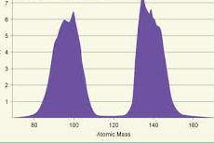
Brownian shape evolution
can be simulated as a random walk
on the potential-energy surface U(q):
Walk until the neck
has become thin ...
Start near the
ground state
Asymmetry α
… then bin the
mass asymmetry
Elongation Q₂
=> Y(A):
²³⁶U

Slide 25
The very first Brownian results:
J. Randrup & P. Möller, PRL 106 (2011) 132503
²⁴⁰Pu
²³⁶U
E* = S_{n}
E* = S_{n}
6.53 MeV
6.54 MeV
²³⁴U
²³⁴U
E* = S_{n}
E* ≈ E_{GDR}
6.84 MeV
11 MeV
Odd-even staggering of Y(Z):
PM & JR: PRC 90 (2014) 014601: Y(Z,N)
Energy dependence:
JR & PM, PRC 88 (2013) 064606;
Ward et al, PRC 95 (2017) 024618

Slide 26
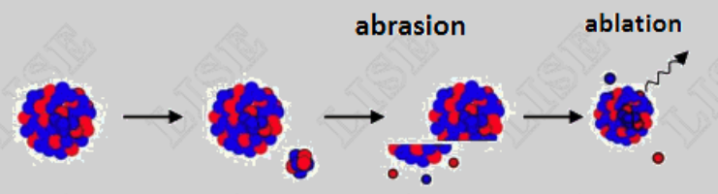
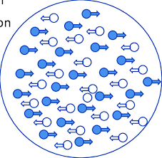
K.-H. Schmidt et al., Nucl. Phys. A 665 (2000) 221
Measured the fragment charge distributions Y(Z_{F})
from fission of seventy radioactive nuclei
in one single experiment at GSI
²³⁸U
^{A}Z
Z₂
1 A GeV
Z₁
Be
Pb
Abrasion-Ablation:
Giant Dipole Resonance
E* ≈ 11 MeV

Slide 27
K.-H. Schmidt et al.,
Nucl. Phys. A 665 (2000) 221:
Fission fragment charge distributions
for seventy radioactive nuclei at GSI
100
Protons Z
50
²³⁸U
^{A}Z
Z₂
1 A GeV
Z₁
Be
Pb
50
100
150
Neutrons N

Slide 28
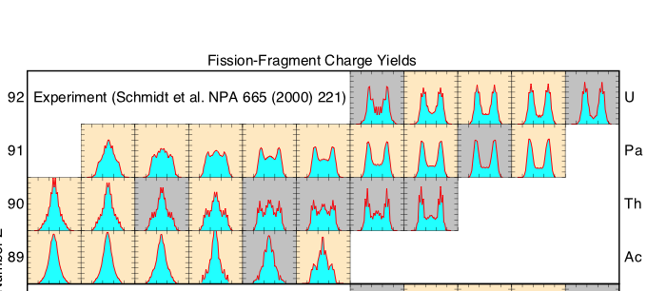
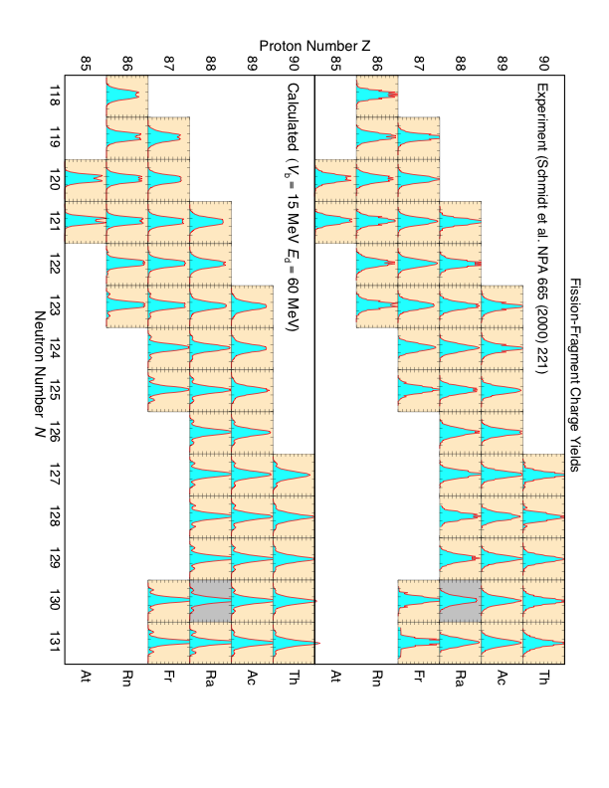
Comparison of P(Z_{f}) with data by KHS et al. (preliminary)
Data: K.H. Schmidt et al., Nucl. Phys. A665 (2000) 221:
Brownian shape motion
works remarkably well
=> Use it to predict Y(A)
Calculation: Brownian shape evolution
P. Möller & J. Randrup, PRC 88, 064606 (2013)

Slide 29

Survey calculation of fission fragment yields
74$≤Z≤94 and 90≤N≤$150
100
987 nuclides
Protons Z
50
50
100
150
Neutrons N

Slide 30
²³⁶U
¹⁸⁰Hg
P. Möller & J. Randrup,
PRC 91, 044316 (2015):
Y(A) for 987 nuclides
A.N. Andreyev et al.,
PRL 105, 252502 (2010)

Slide 31
Experimental verification of the predicted asymmetric region
Experiment: P. Morfouace et al., Nature 641, 339 (2025):
An asymmetric fission island driven by shell effects in light fragments
100 charge yields
R3B/SOFIA
Prediction: P. Möller & J. Randrup, Phys. Rev. C 91, 044316 (2015)

Slide 32

Extended survey calculation of fission fragment yields
74$≤Z≤126 and 92≤N≤23$0
Superheavy
nuclei
100
Protons Z
896 even-even nuclides
50
50
100
150
Neutrons N

Slide 33
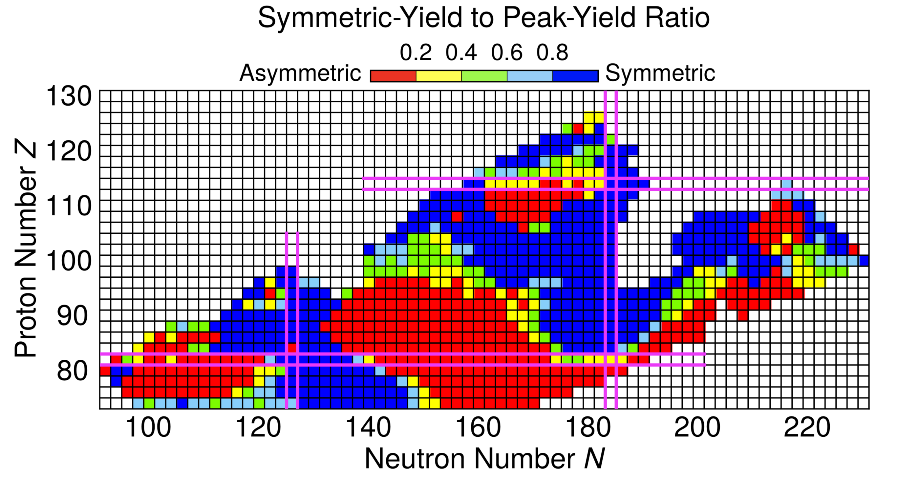
Extended survey calculation of fission fragment yields
M. Albertsson, G. Carlsson, T. Døssing, P. Möller, J. Randrup, and S. Åberg,
European Physical Journal A 56 (2020) 56: Y(A) for 896 even-even nuclides

Slide 34
²⁸⁰Cn
²³⁶U
100
²⁰⁸Pb
Protons Z
¹³²Sn
50
Actinide --> ≈ ¹³²Sn + X ( ≈ 2 : 3 )
SuperHeavy --> ≈ ²⁰⁸Pb + X ( ≈ 1 : 3 )
50
100
150
Neutrons N
M. Albertsson, G. Carlsson, T. Døssing, P. Möller, J. Randrup, and S. Åberg,
European Physical Journal A 56 (2020) 56: Y(A) for 896 even-even nuclides

Slide 35
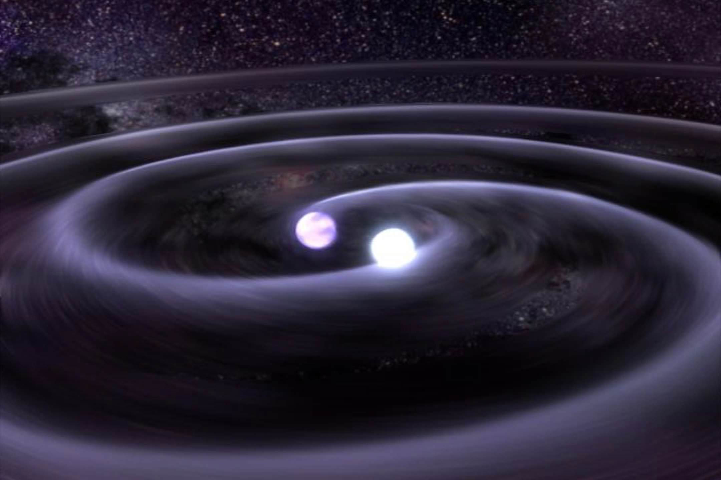
The r-process generates the heavier nuclei, determining the elemental abundances
Neutron star mergers
generate high neutron flux
Fission terminates the r-process
=> No superheavy nuclei formed
Fission plays a role in the r-process:
Causes fission recycling
Fission contributes to the
final element abundances

Slide 36
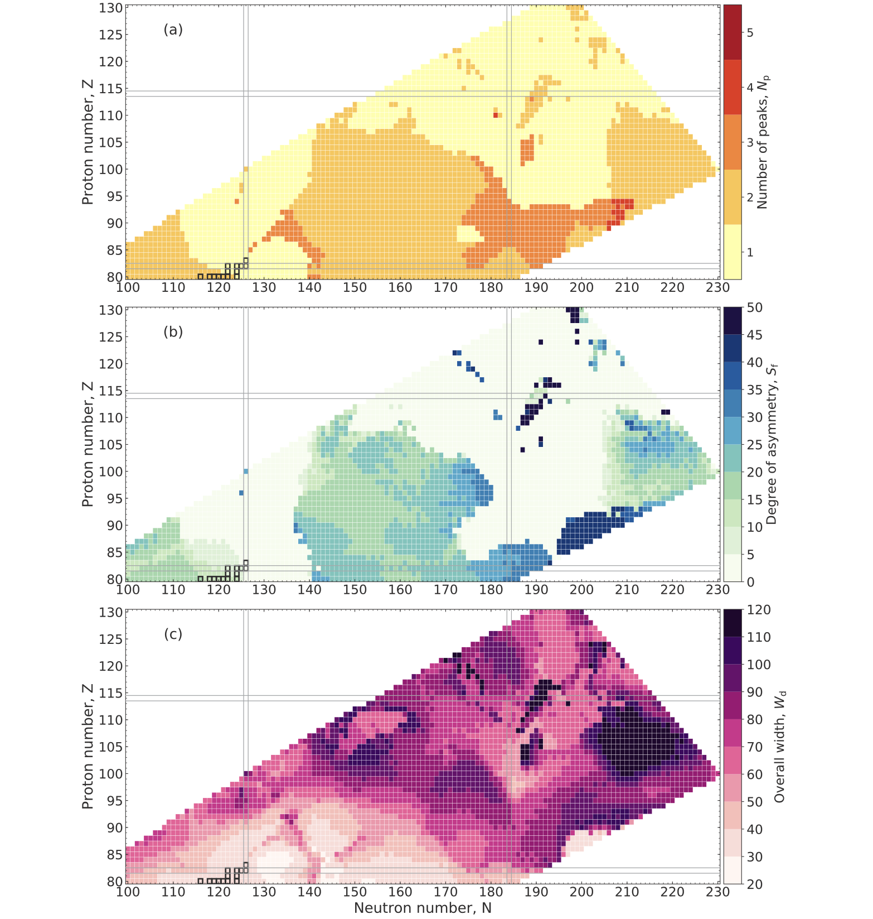
Primary fission fragment mass yields across the chart of nuclides
10⁶ Brownian shape evolutions
on 5D potential-energy surfaces
for 3800 neutron-rich nuclides
Number of peaks in Y(A)
M.R. Mumpower, P. Jaffke, M. Verriere,
J. Randrup, Phys Rev C 101, 054607 (2020)
Asymmetry in Y(A)
Fission during the r-process:
Fission terminates the r-process
=> No superheavy nuclei formed
Causes fission recycling
Width of main peak in Y(A)
Fission contributes to the
final element abundances

Slide 37
NEW AREA OF APPLICATION: FUSION
Formation of superheavy nuclei
²⁵⁸Rf
²⁰⁸Pb
⁵⁰Ti
⁴⁸Ca
⁵⁰Ti
Target: ²⁰⁸Pb
⁵⁴Cr
⁵⁸Fe
M. Albertsson, B.G. Carlsson, T. Døssing, J. Randrup, D. Rudolf, and S. Åberg, Phys. Rev. C 110, 014624 (2024)

Slide 38
Refinement:
Replace the Fermi-gas density of state
with the microscopic density of states
ρ_{FG}(E*(q)) → ρ_{micro}(E; q)
Depends only on the local
excitation E*(q) = E – U(q)
Depends on the structure
of a nucleus with shape q
Three examples where the
shape-dependent microscopic density of states
plays a key role

Slide 39
EXAMPLE 1:
Energy dependence of the symmetric fragment yield
²³⁴U(E* = 6.54 MeV)
²³⁴U(E* ≈ 11.0 MeV)
²³⁴U
²³⁴U
E* = S_{n}
E* ≈ E_{GDR}
6.84 MeV
11 MeV
4 qp
2 qp
Region near minimum:
Low s-p level density
=> δE_{sh}: large
=> δE_{pc}: small
Barrier region:
High s-p level density
=> δE_{sh}: small
=> δE_{pc}: large
Generally, one would expect the peaks to broaden as E* is increased
Counter-intuitive experimental finding:
The symmetric fission yield may have a non-monotonic energy dependence!
However, experiments indicate that the change is non-monotonic!
Though counter intuitive, such a behavior can be in fact result
from the unusual characteristics of nuclides in the barrier region:
Standard nuclear structure
Abnormal nuclear structure

Slide 40
EXAMPLE 1:
Energy dependence of the symmetric yield for ²³⁶U(n,f)
Asymmetry α
Elongation Q₂

Slide 41
EXAMPLE 1:
Energy dependence of the symmetric yield for ²³⁶U(n,f)
First over the
asymmetric barrier
Then around
the sloping ridge
Figure made by
Takatoshi Ichikawa:
PRC 86 (2012) 024610

Slide 42
Paring structure in the transmission rate

Slide 43
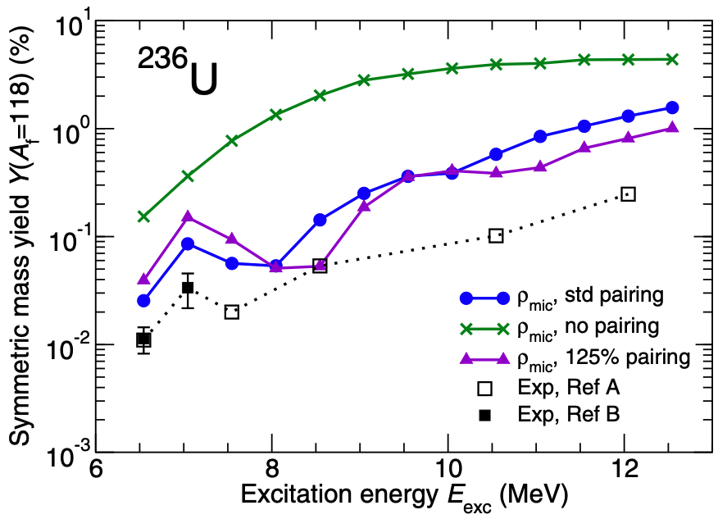
Paring structure in the microscopic density of states
=> Non-monotonic energy dependence of Y(A)
No pairing
Standard
Enhanced
DE Ward, BG Carlsson, T Døssing, P Möller, J Randrup, S Åberg, PRC95 (2017) 024618

Slide 44
EXAMPLE 2:
Division of excitation energy between the fragments

Slide 45
EXAMPLE 2:
Division of excitation energy between the fragments
The mean neutron multiplicity ν exhibits a sawtooth
shape as a function of the fragment mass number A
²³⁵U(n_{th},f)
Fragment mass number A
The sawtooth can be understood from
the structure of the scission configurations
that the Brownian shape diffusion leads to

Slide 46
Partition of the excitation energy at scission
Density of states in
the proto fragments
Available excitation
energy at scission
Statistical
(microcanonical)
energy sharing:
P(E_{H}*;E*) ~ ρ_{L}(E*-E_{H}*;ε_{L}) ρ_{H}(E_{H}*;ε_{H})
E* = E_{L}* + E_{H}*
E*=10 MeV
E*=20 MeV
E*=40 MeV
A_{L}:A_{H} = 106:130
E_{L}*
E_{H}*
Light fragment
is favored:
E_{L}*
E_{H}*
ε_{L}
ε_{H}
106:130
E_{L}*
E_{H}*
A_{L}:A_{H} = 84:152
Heavy fragment
is favored:
E_{L}*
E_{H}*
ε_{L}
ε_{H}
Macroscopic
(Fermi-gas) ρ_{FG}
84:152
Microscopic
(shape-dep) ρ_{micro}
M. Albertsson, B.G. Carlsson, T. Døssing, P. Möller,
J. Randrup, and S. Åberg, PLB 803 (2020) 135276

Slide 47
Partition of the excitation energy at scission
Density of states in
the proto fragments
Available excitation
energy at scission
Statistical
(microcanonical)
energy sharing:
P(E_{H}*;E*) ~ ρ_{L}(E*-E_{H}*;ε_{L}) ρ_{H}(E_{H}*;ε_{H})
E* = E_{L}* + E_{H}*
E*=10 MeV
E*=20 MeV
E*=40 MeV
ρ_{L} >> ρ_{H}
A_{L}:A_{H} = 106:130
Light fragment
is favored:
E_{L}*
E_{H}*
ε_{L}
ε_{H}
106:130
A_{L}:A_{H} = 84:152
Heavy fragment
is favored:
E_{L}*
E_{H}*
ε_{L}
ε_{H}
Macroscopic
(Fermi-gas) ρ_{FG}
84:152
Microscopic
(shape-dep) ρ_{micro}
M. Albertsson, B.G. Carlsson, T. Døssing, P. Möller,
J. Randrup, and S. Åberg, PLB 803 (2020) 135276

Slide 48
Partition of the excitation energy at scission
Density of states in
the proto fragments
Available excitation
energy at scission
Statistical
(microcanonical)
energy sharing:
P(E_{H}*;E*) ~ ρ_{L}(E*-E_{H}*;ε_{L}) ρ_{H}(E_{H}*;ε_{H})
E* = E_{L}* + E_{H}*
E*=10 MeV
E*=20 MeV
E*=40 MeV
ρ_{L} >> ρ_{H}
A_{L}:A_{H} = 106:130
Light fragment
is favored:
E_{L}*
E_{H}*
ε_{L}
ε_{H}
106:130
A_{L}:A_{H} = 84:152
ρ_{L} << ρ_{H}
Heavy fragment
is favored:
E_{L}*
E_{H}*
ε_{L}
ε_{H}
84:152
M. Albertsson, B.G. Carlsson, T. Døssing, P. Möller, J. Randrup, and S. Åberg, PLB 803 (2020) 135276

Slide 49
Neutron evaporation from each fission fragment => ν (A)
Energy dependence of ν (A)
ρ_{FG}
ρ_{micro}
106:130 Light fragment is favored
84:152 Heavy fragment is favored
Calculation:
M. Albertsson, B.G. Carlsson, T. Døssing, P. Möller,
J. Randrup, and S. Åberg, PLB 803 (2020) 135276
Data: R. Müller, A.A. Naqvi, F. Käppeler,
F. Dickmann, PRC 29 (1984) 885

Slide 50
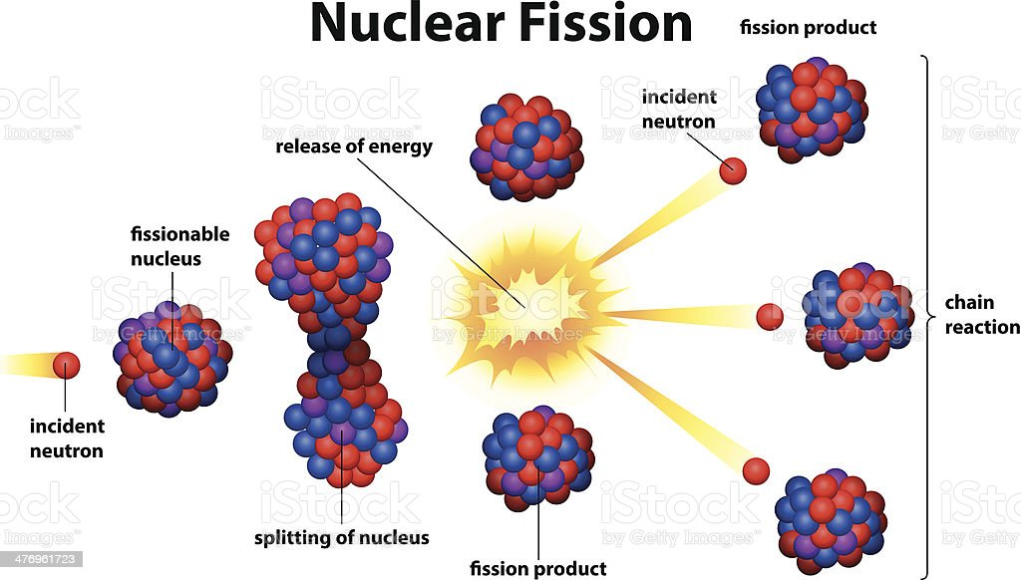
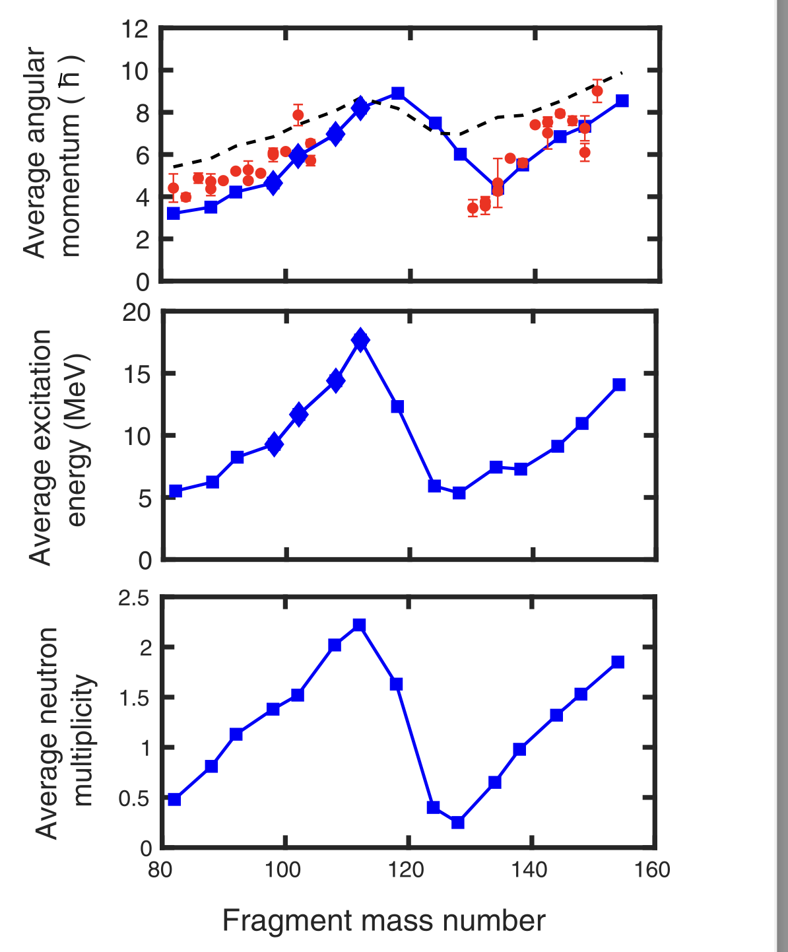
EXAMPLE 3:
Dependence of the fragment angular momentum on A
J
Statistical equilibrium for
each scission configuration
E*
< J >(A) Σ_{J} J ρ_{A}(E*,J)
~
Fragment
excitation
Microcanonical sharing
of the excitation energy
<E*>(A)
A

Slide 51
EXAMPLE 3:
A dependence of the fragment angular momentum
Statistical equilibrium for
each scission configuration
< J >(A) Σ_{J} J ρ_{A}(E*,J)
~
Fragment angular momentum
J
<J>(A)
Statistical population
of rotational states
Data: J Wilson et al.,
Nature 590 (2021) 566
=>
=>
Fragment
excitation
<E*>(A)
Microcanonical sharing
of the excitation energy
A
T. Døssing, S. Åberg, M. Albertsson, B.G. Carlsson, and J. Randrup, Phys. Rev. C 109, 034615 (2024)

Slide 52
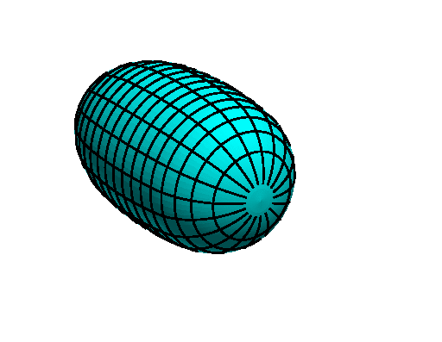



Summary
At moderate excitations, the nuclear many-body system consists of nearly
independent quasi-particles in the evolving effective single-particle field
The time-dependent mean field agitates the quasi-particles,
producing a strong dissipative force on the shape evolution
Brownian
motion
In that limit, the shape evolution can be simulated as a random walk
guided by the local (shape-dependent) density of states ρ(E;q)
ρ(E;q)
Within this simple framework, the nuclear shape evolution can be calculated
=> Fission: fragment mass (& charge) yields: Y(A), Y(Z,N); TKE(A)
=> Fusion: formation of superheavy nuclei
Milestone paper
Refinement: Use the shape-dependent microscopic density of states
ρ_{micro}(E;q)
=> Non-monotonic energy dependence of Y(A)
=> Division of excitation energy between the fragments: E_{L}* : E_{H}*, <ν>(A)
=> The (correlated) fragment angular momenta: P(J_{L} , J_{H}), incl. <J_{F}>(A)
The union of (macroscopic) dynamics with (microscopic) structure
results in a calculational tool with unprecedented predictive power
No new
parameters
Quantum many-body dynamics made tractable

Slide 53
Physics Colloquium, Thursday, May 7, 2026
Nuclear Fission as Brownian motion
Quantum many-body dynamics made tractable
Thank You!
Jørgen Randrup
Lawrence Berkeley National Laboratory

