Slide 1
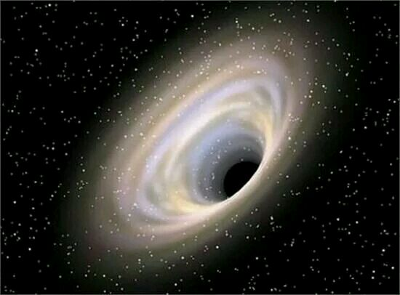
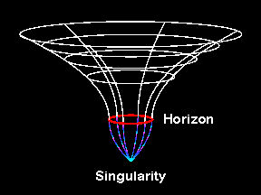
The Wonderful Physics of Black holes
Bin Chen
NBU/PKU
IOPP-CCNU，2026-3-31

Slide 2
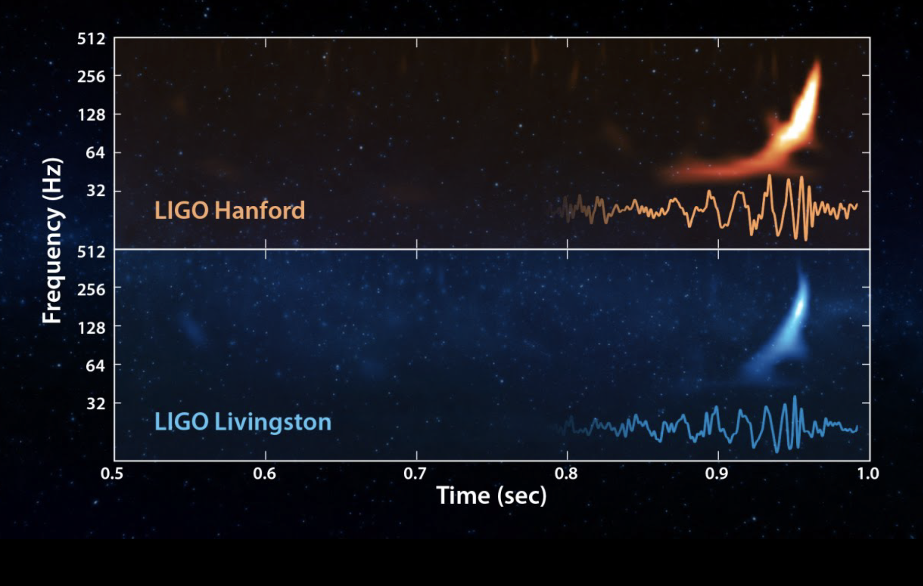
GW150914

Slide 3
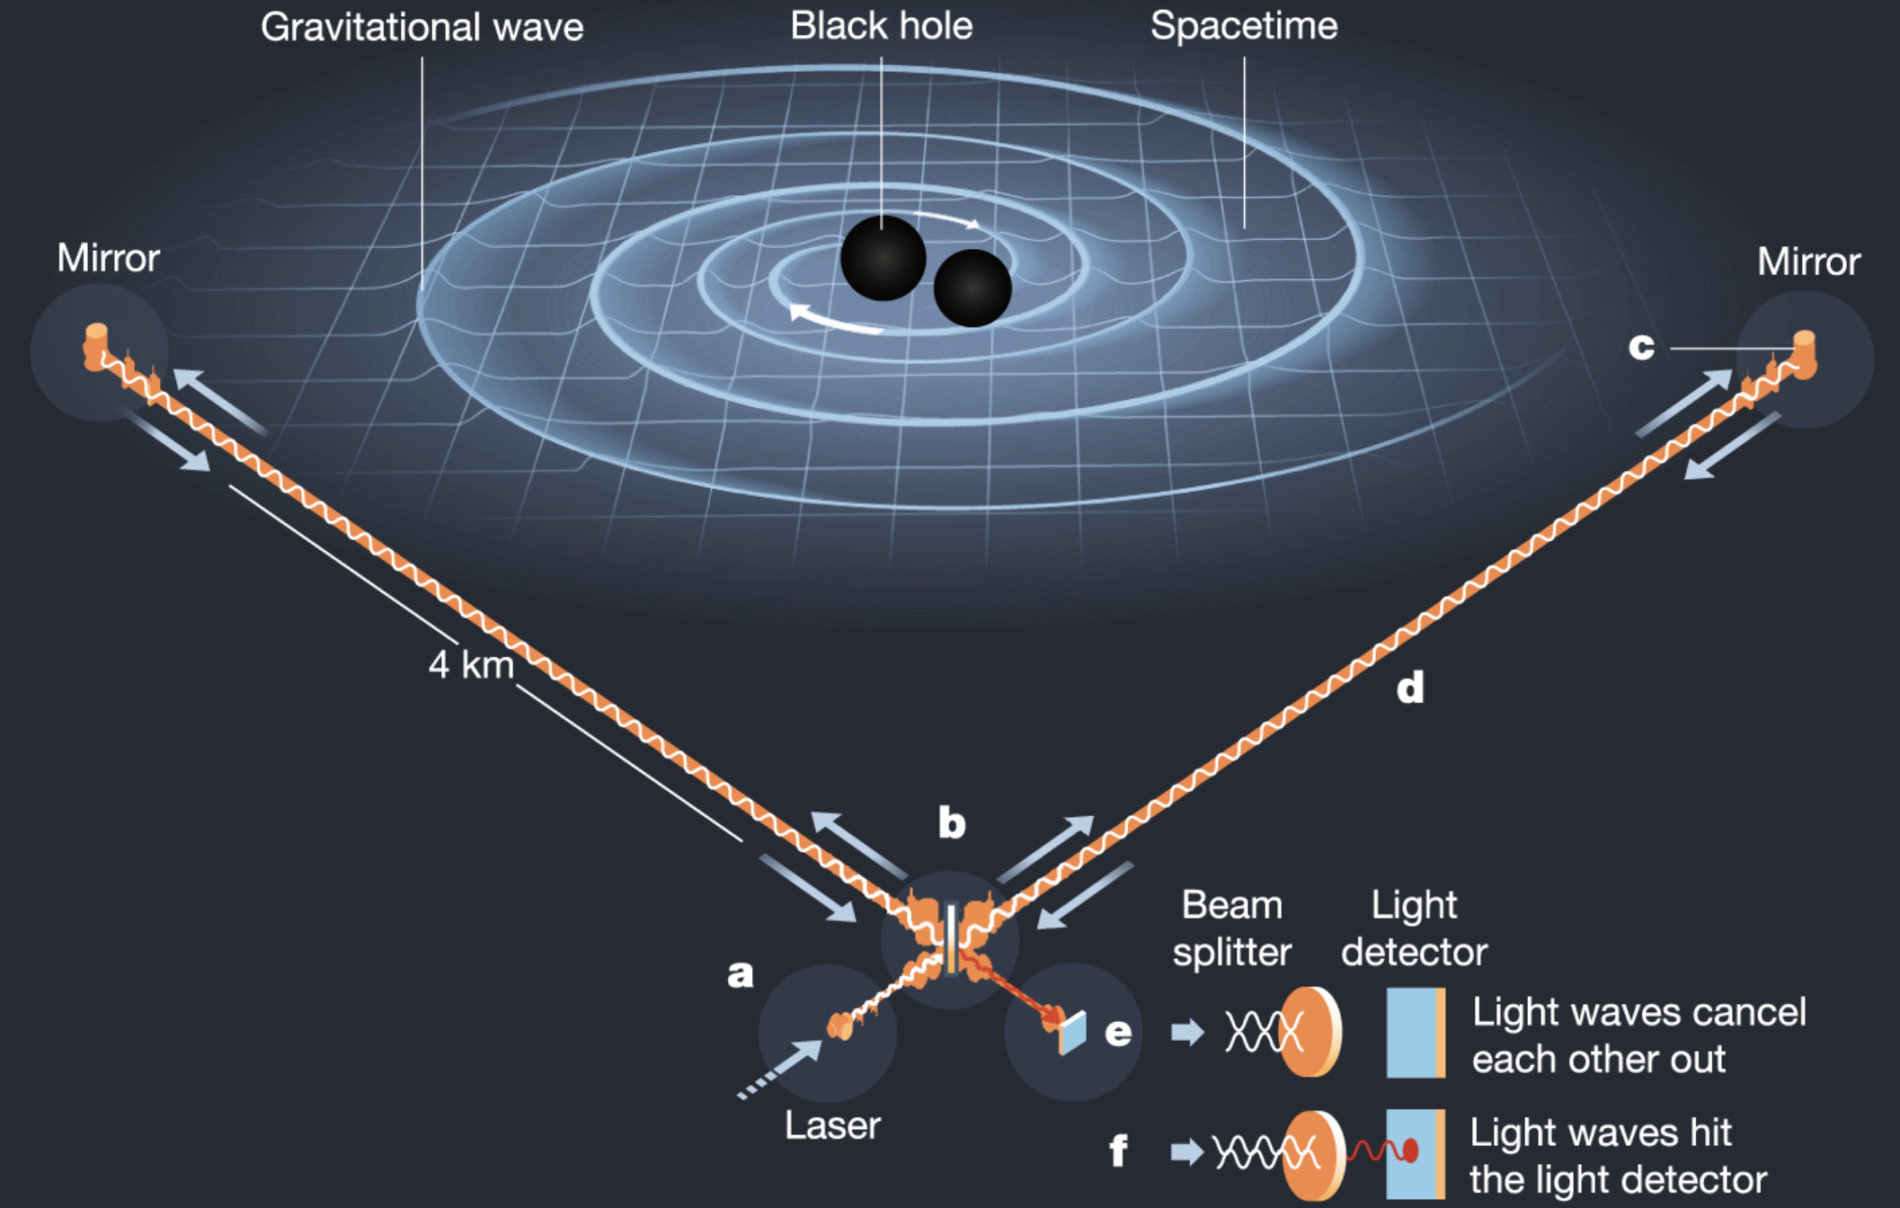
The merger of BH binary

Slide 4
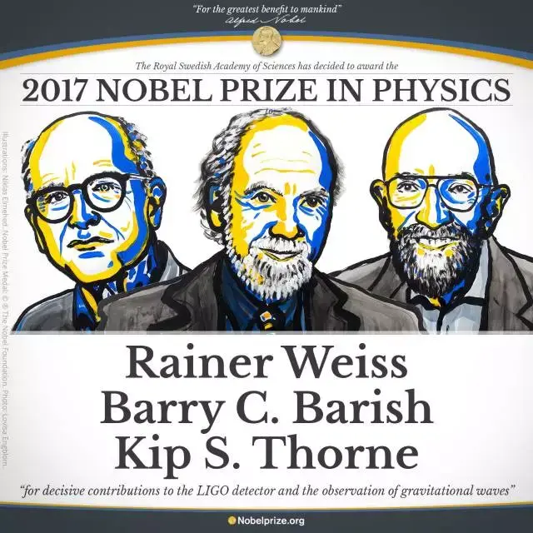

Slide 5
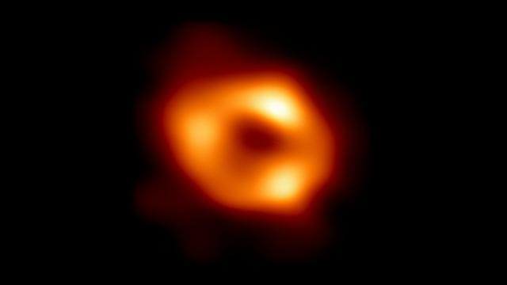
Image of Sgr A*（2022，5，12）
About 4 million solar-mass

Slide 6
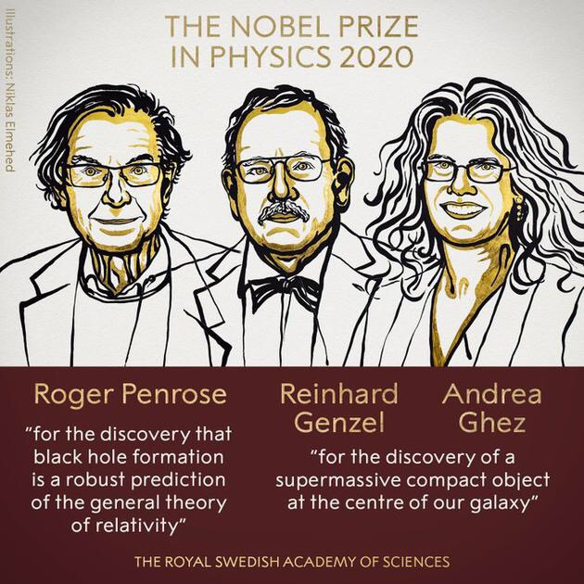

Slide 7
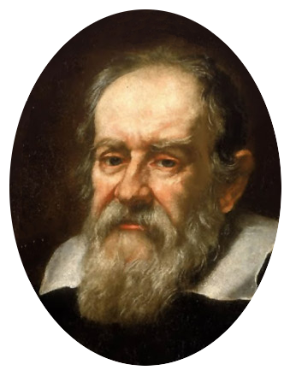
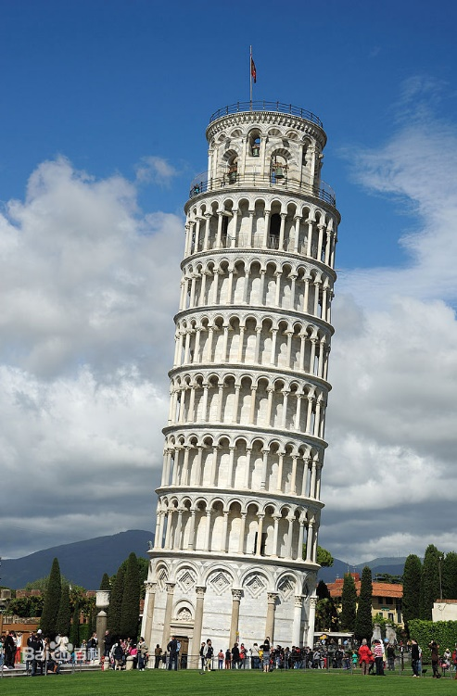
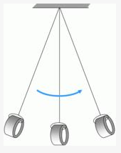
Galileo Galilei
Gravitation on Earth
Gravitational acceleration independent of mass
Weak Equivalence Principle：
Inertial mass=Gravitational mass
Relativistic Principle:
Physical laws in all inertial frames
must take the same form
Galileo Galilei: 1564-1642

Slide 8
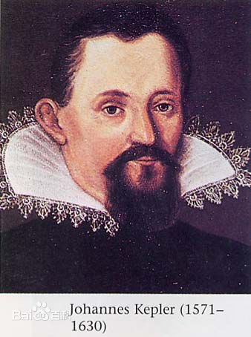
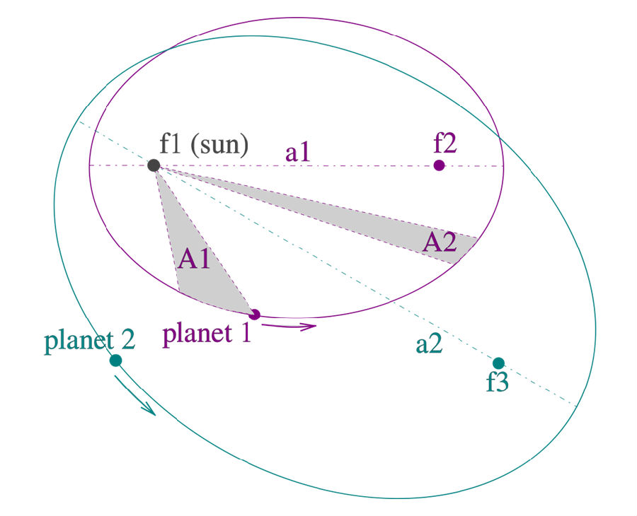
Johannes Kepler
Based on B. Tycho’s observational data
Kepler summarized three laws on plenary motions around the Sun

Slide 9
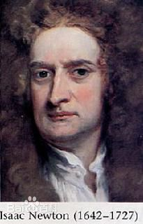
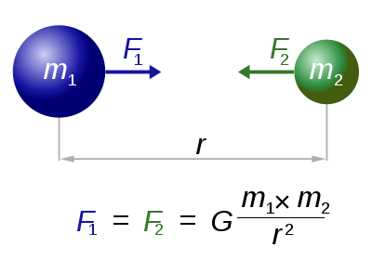
Issac Newton
Gravitation is universal between two massive objects
Inverse square law
Great success:
accurately predict the plenary motions
explain the tidal phenon.
predict the existence of Neptune

Slide 10
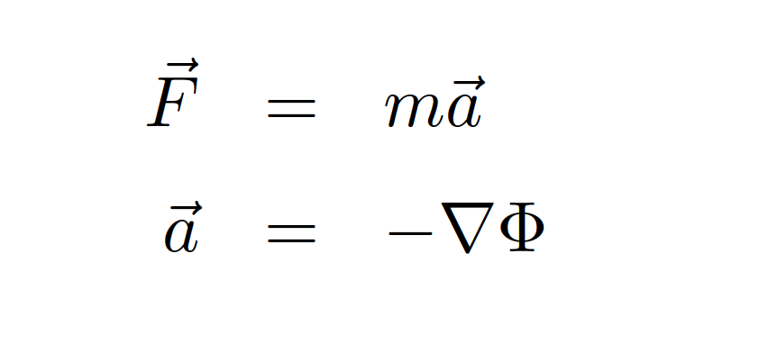

Newtonian gravity
Well developed in 18-19th century：Newton, Laplace, Poisson, Hamilton, et al
Tiny anomaly in perihelion precession of Mercury

Slide 11
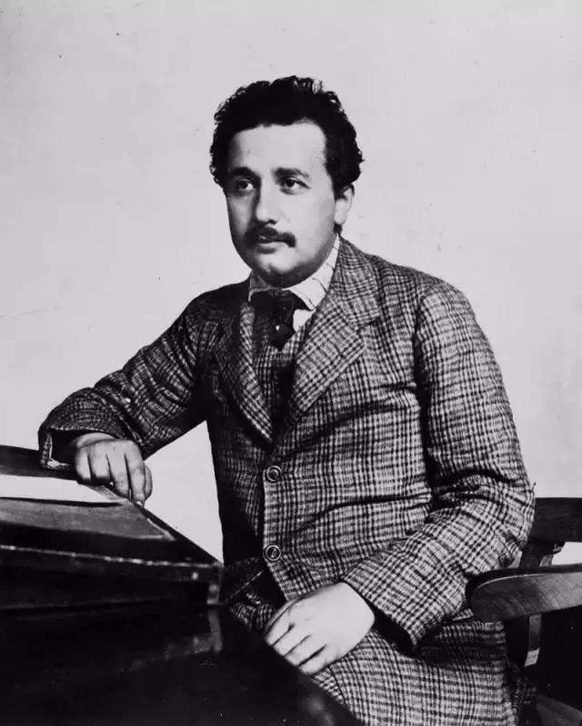
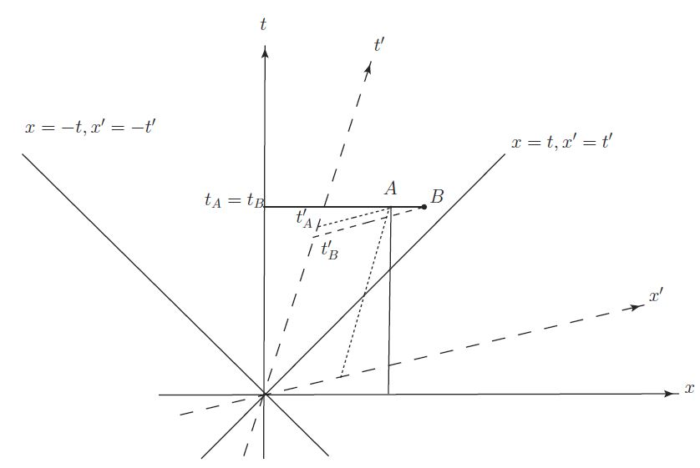
Special Relativity（1905）
Relativistic principle
The speed of light is a constant
Time and space is unified into spacetime
Flat spacetime

Slide 12
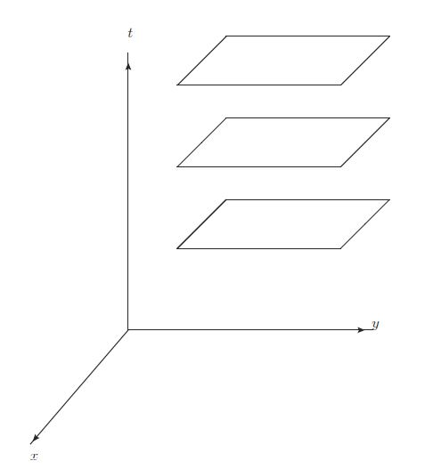
Inconsistency between SR and Newtonian gravity (1908)
Newtonian gravity
Absolute time
Instantaneous propagation
Non-relativistic
Relativistic theory of gravitation?

Slide 13
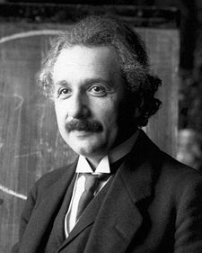
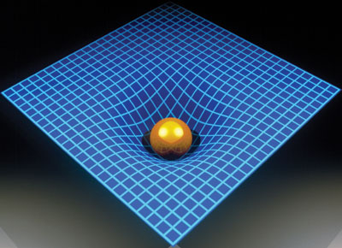

General Relativity (1915)
Einstein’s theory about time, space,
and gravitation
GR（1915）：curved spacetime
gravitation= curvature
Spacetime is dynamical!

Slide 14
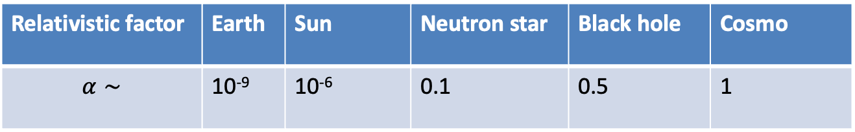
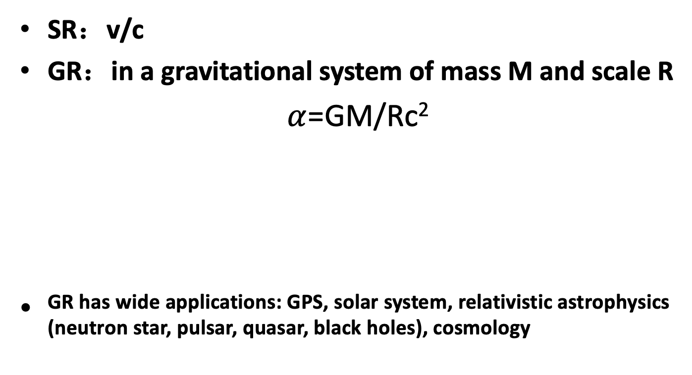
Relativistic effect
SR：v/c
GR：in a gravitational system of mass M and scale R
$α$=GM/Rc²
GR has wide applications: GPS, solar system, relativistic astrophysics (neutron star, pulsar, quasar, black holes), cosmology
Relativistic factor | Earth | Sun | Neutron star | Black hole | Cosmo
$$α∼$$ | 10⁻⁹ | 10⁻⁶ | 0.1 | 0.5 | 1

Slide 15
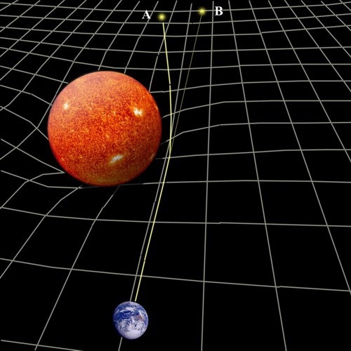
Deflection of light: fundamental principle of gravitational lensing

Slide 16
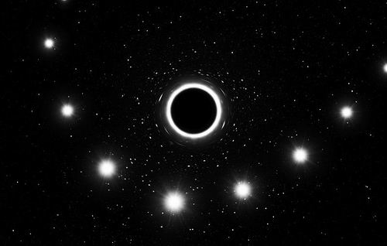
Gravitational redshift
随着S2恒星通过银河系中央的黑洞，强大的引力场导致其光线向光谱的红色一端移动 （2018年）

Slide 17
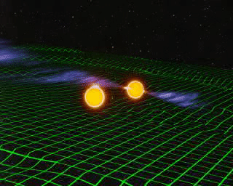
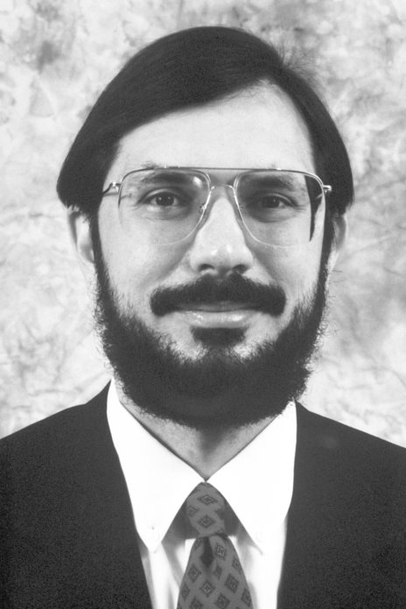
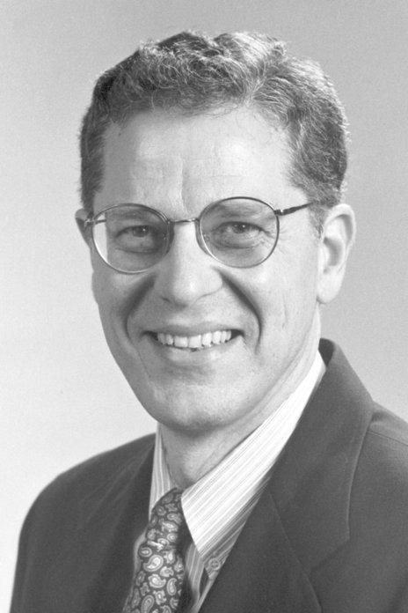
Pulsar binary
Pulsar: rotating neutron of high spin
PSR B 1913+16 （1974）
High-precision tests of GR
Significant relativistic effects
Indirect evidence of GW
Pulsar-timing array (PTA)
Hulse and Taylor: 1993 Nobel Prize

Slide 18
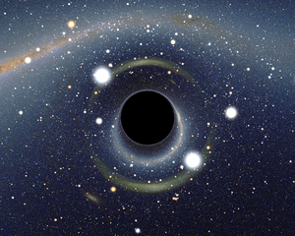
Black holes：extremely relativistic objects
Classically, black holes looks totally “black” for an outside observer
They absorb everything, even photons cannot escape

Slide 19
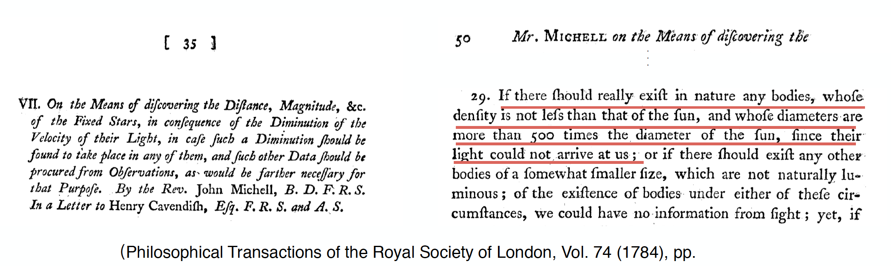
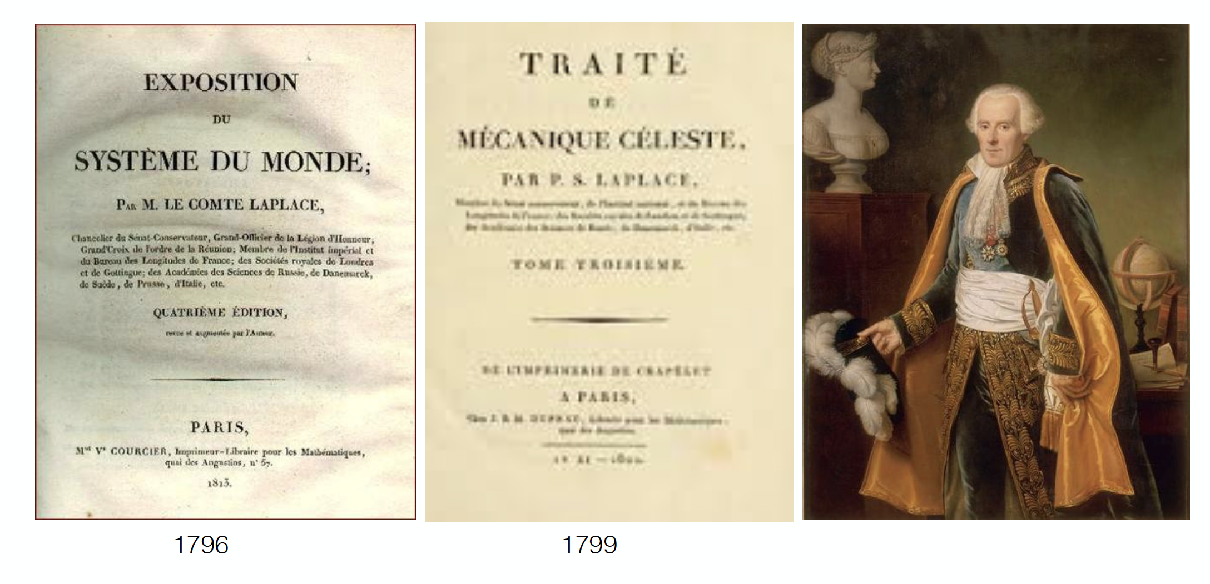
Black holes in Newtonian gravity

Slide 20
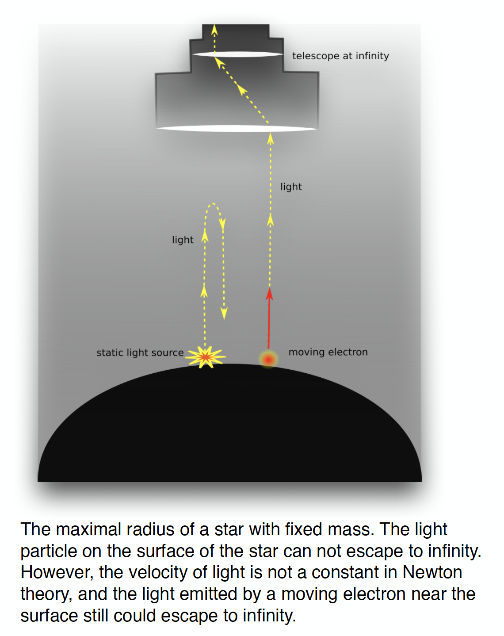
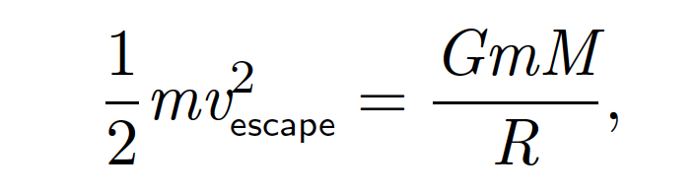
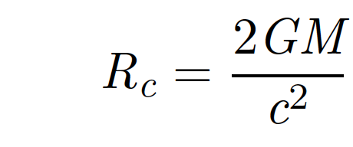
Dark star

Slide 21
Black holes in GR
Existence of (event) horizon
Intrinsic singularity in black hole
They may be formed from the collapse of star, primordial perturbation, or even in colliders
Violent dynamics: merge, accretion, …

Slide 22
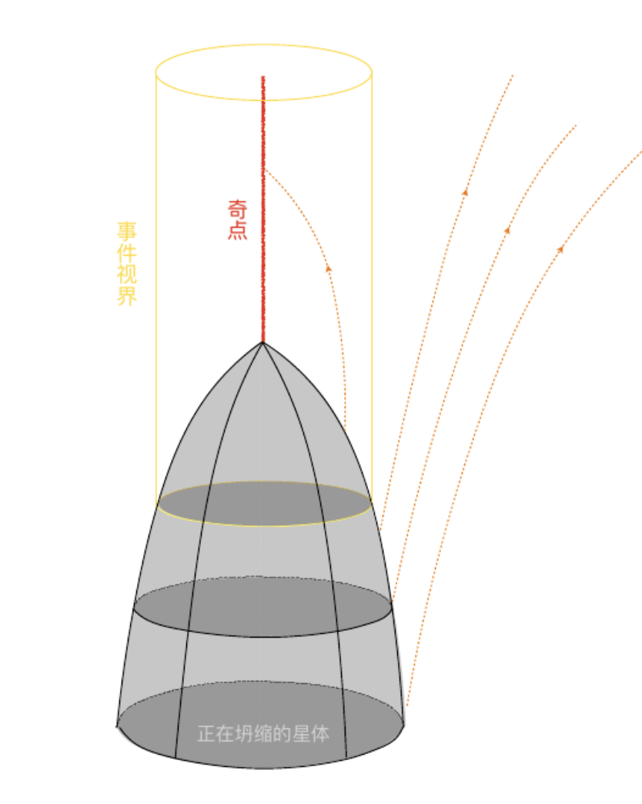
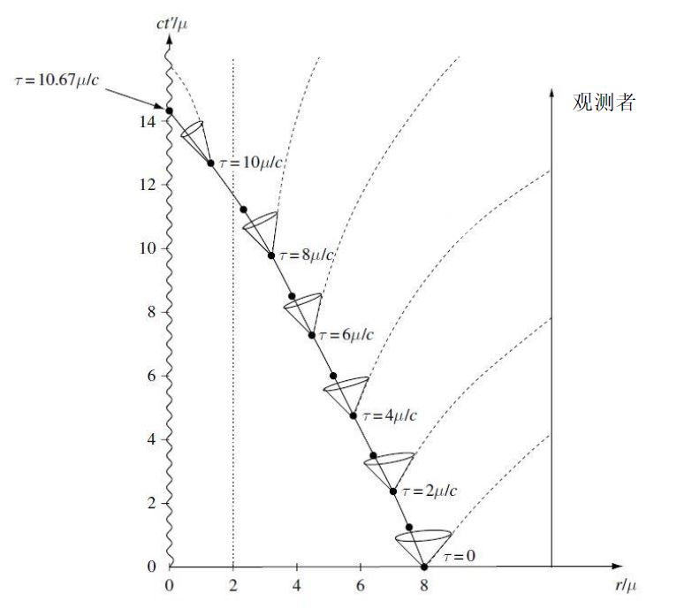
Frozen star

Slide 23
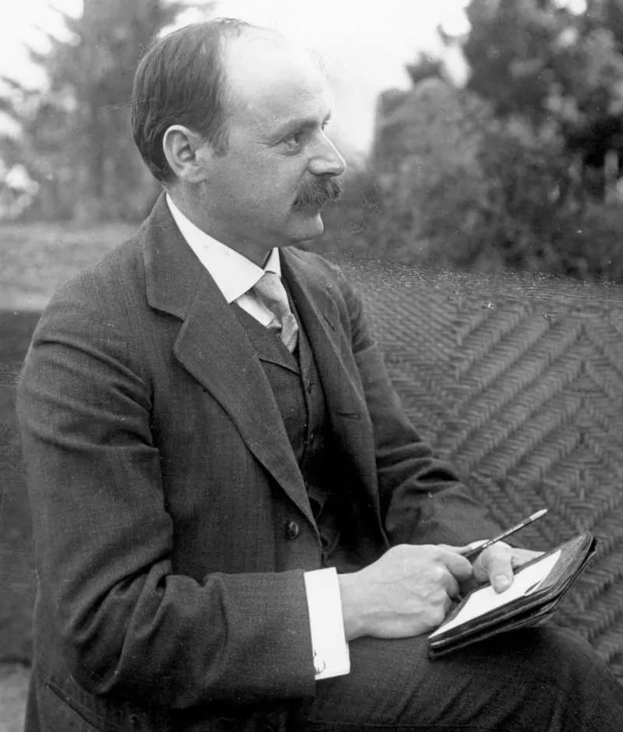
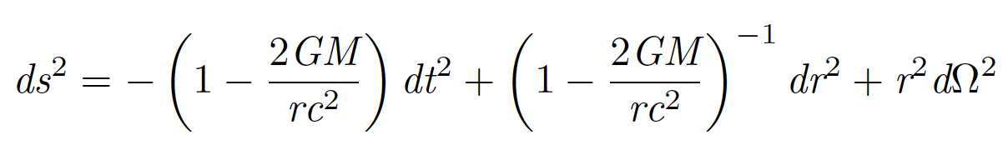
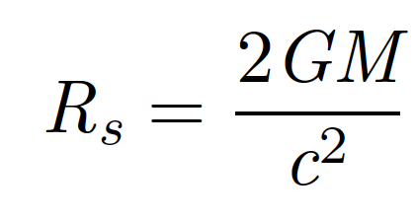
Schwarzschild spacetime
Spherically symmetric
Sch. Radius (horizon)
For sun，3km; for Earth, 9mm
Intrinsic singularity: r=0
Karl Schwarzschild (1873-1916)

Slide 24
History of black hole study（1950s-1964）
Extension of Sch. spacetime（Eddington, Synge, Kruskal &Szekeres)
Rindler（1956）: notion of horizon
Finkelstein （1958）: event horizon as causal barrier
Penrose (1962) : Penrose diagram
Schmidt (1963) : Quasar
Kerr(1963) : solution of stationary rotating spacetime
J. Wheeler (1967): the term of “Black hole”, replacing “Frozen star”(Soviet Union) and“Collapsed star”(Western countries)

Slide 25
Golden age of black hole（1964-1975）
R. Penrose (1965) : first singularity theorem
Israel (1967) : uniqueness of static solution in GR
Penrose (1969): Cosmic censorship, event horizon
Penrose & Hawking (1970): Cosmic singularity
Carter (1971): uniqueness of Kerr solution
Wheeler &Ruffini (1971): BH has no hair
Penrose &Floyd (1971): Penrose process
Hawking (1971-72): BH area never decrease
Zeldovich, Misner (1971-72) : BH superradiance
Bekenstein (1972): Area law of BH entropy
Bardeen & Carter &Hawking (1973): Dynamics of BH
Hawking (1973): BH thermodynamics and Hawking radiation

Slide 26
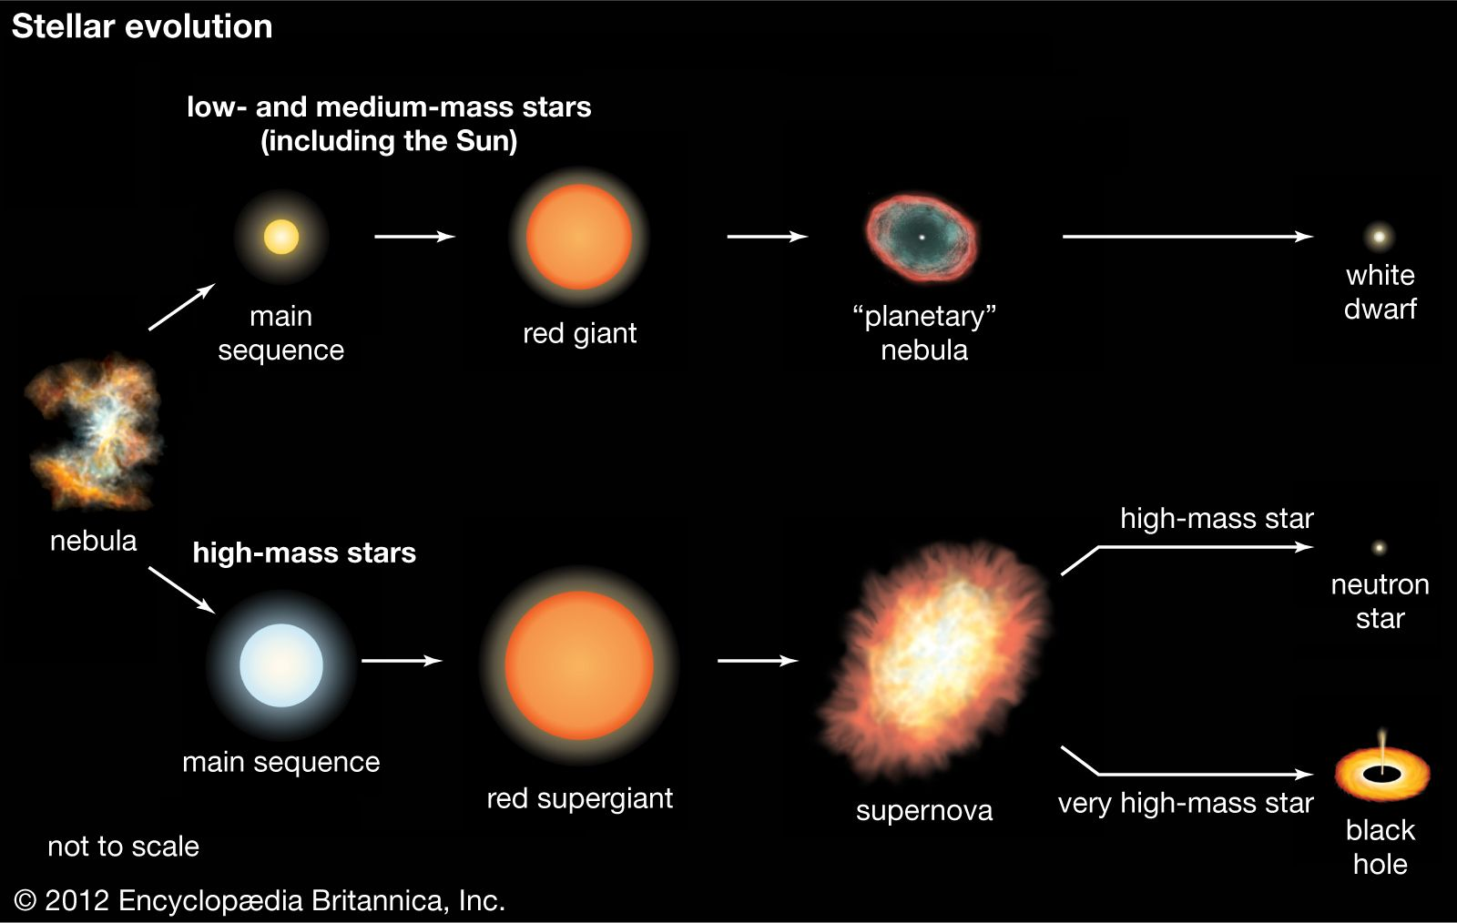
Evolution of Stars

Slide 27
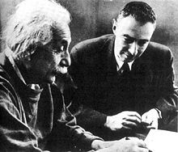
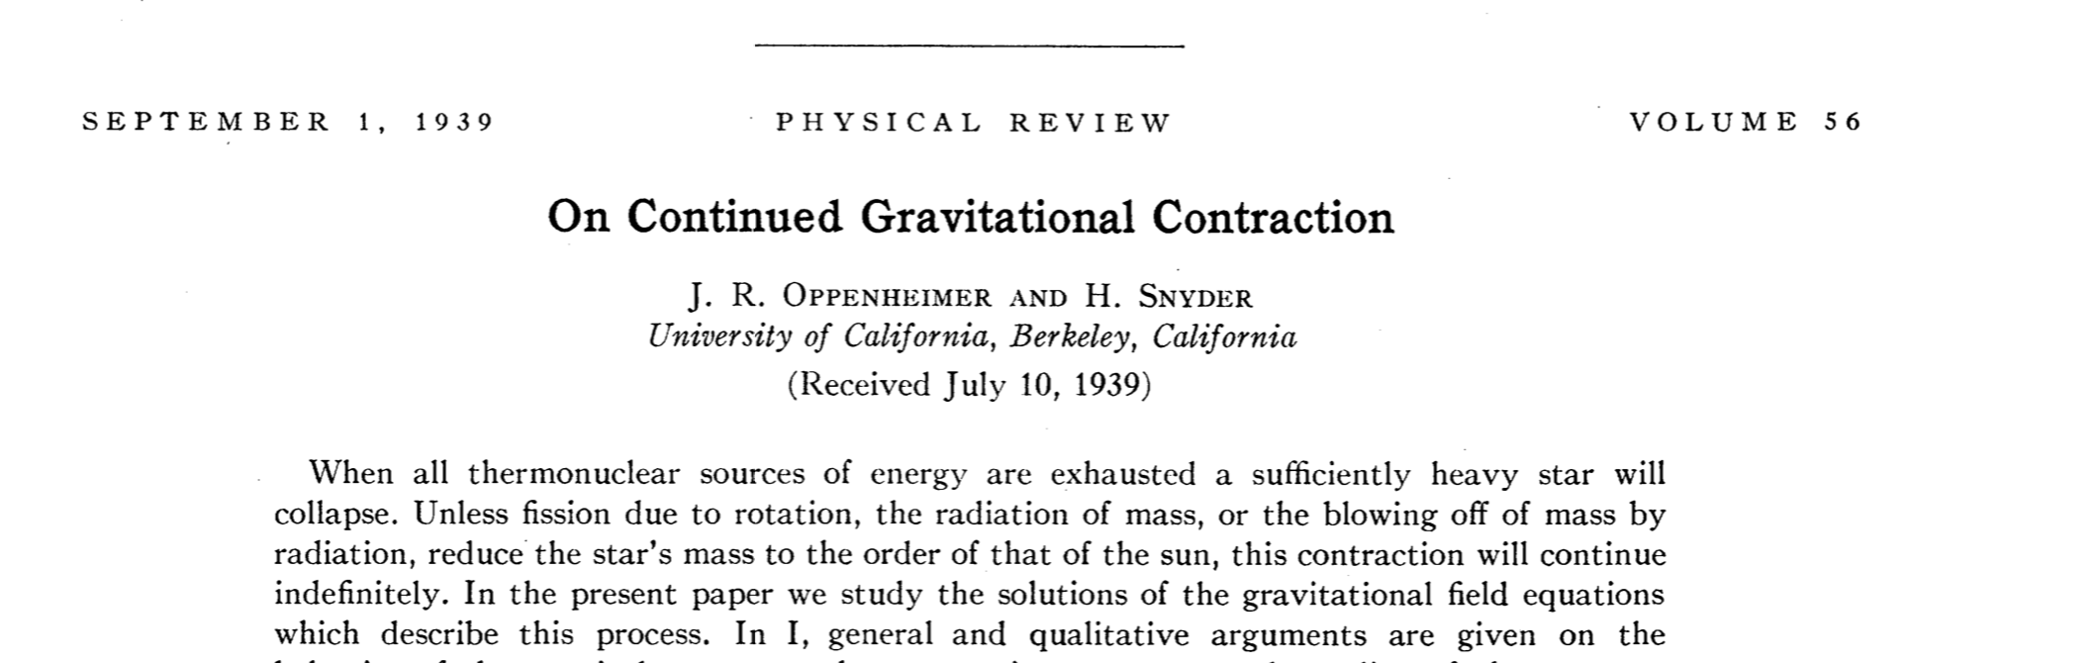
Oppenheimer-Snyder
1930s, Fowler-Chandrasekhar-Landau : white dwarf
1939, Oppenheimer and Snyder: the gravitational collapse of a spherically symmetric star will end at the singularity

Slide 28
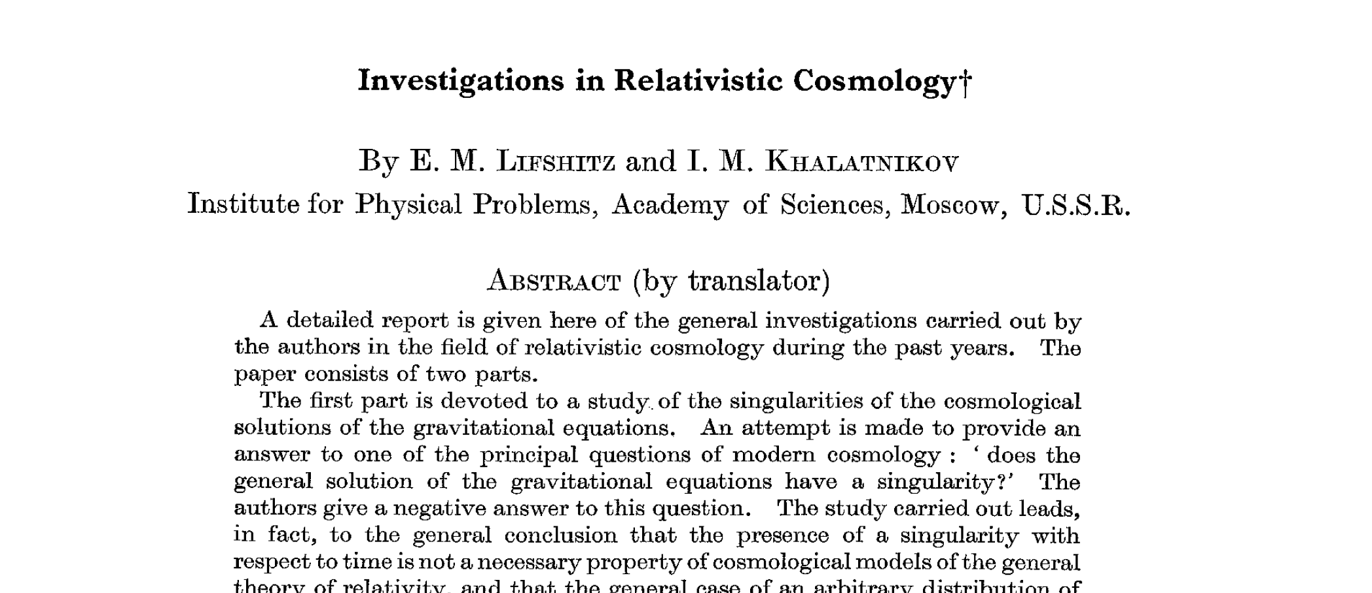
Formation of singularity？
Lifshitz and Khalatnikov(1963): Einstein Eq. is highly nonlinear, the deviation from spherical symmetry stops the formation of the singularity

Slide 29
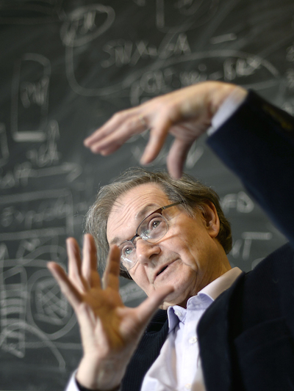
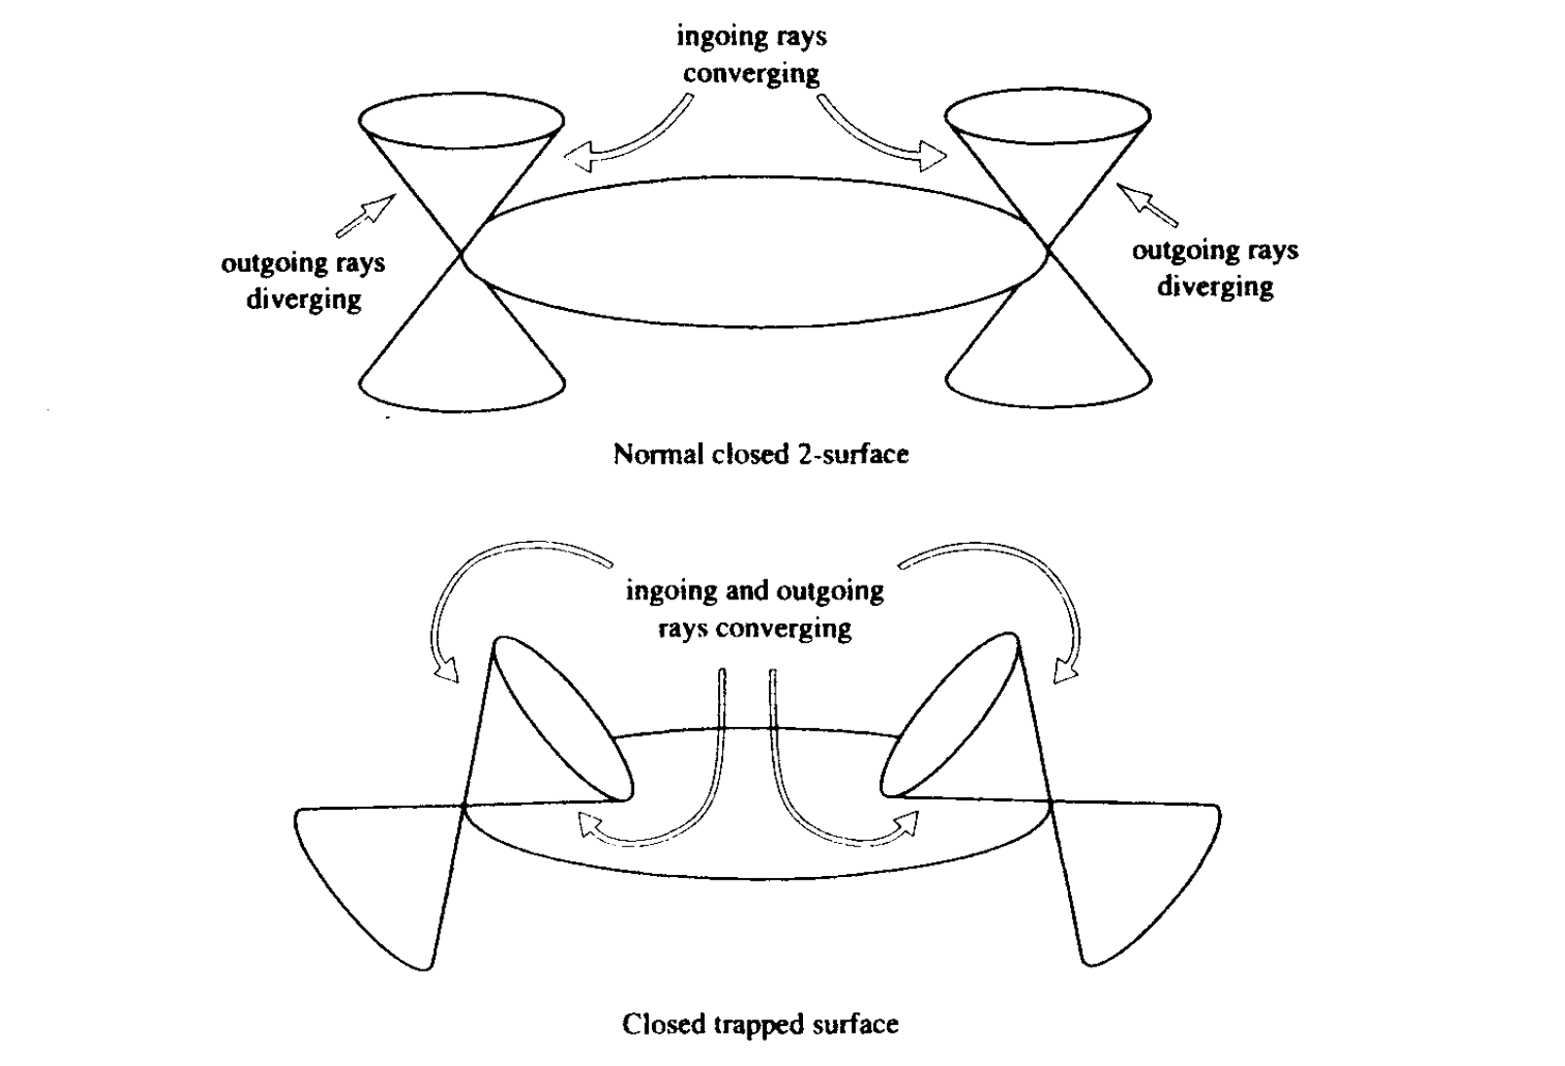
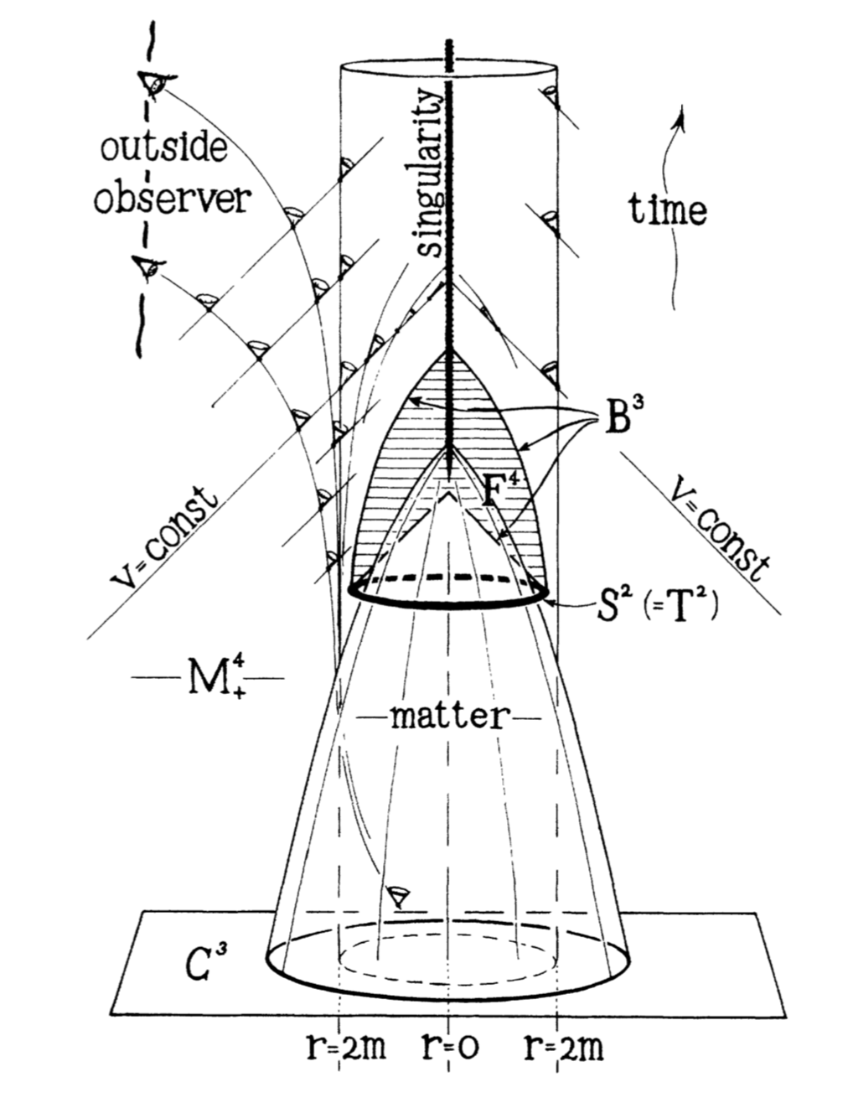
Penrose

Slide 30
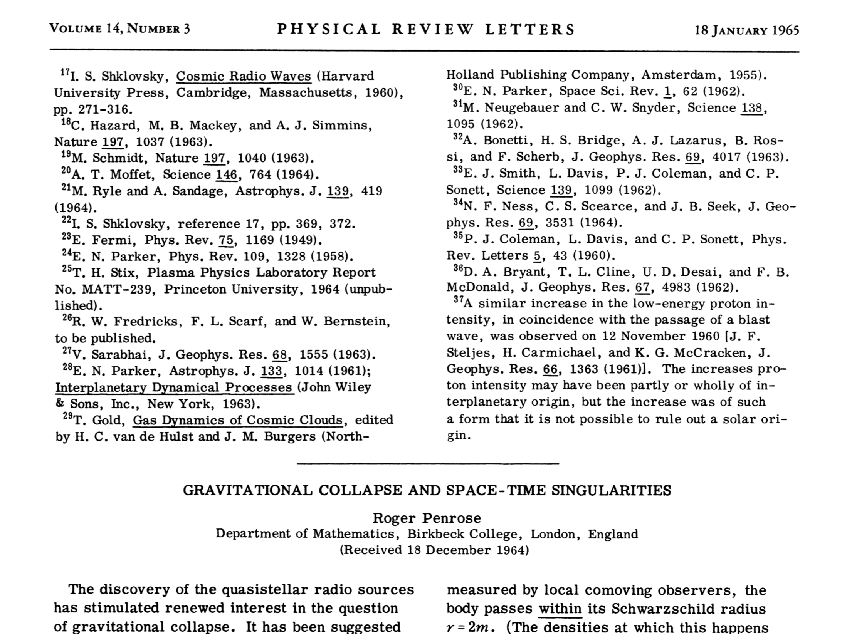

Slide 31
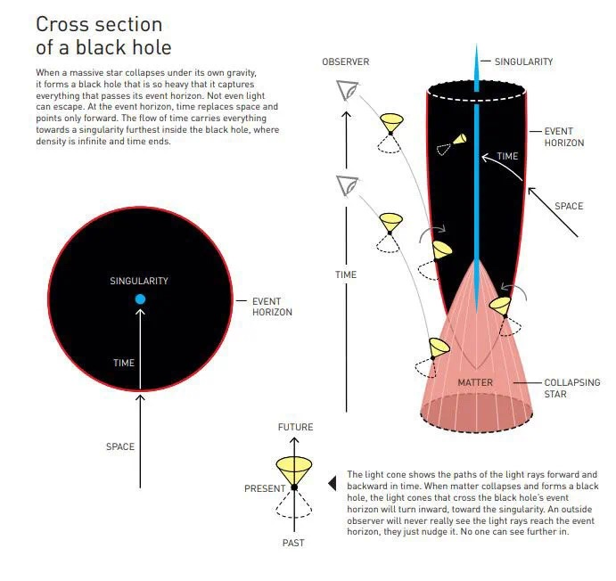
Black hole singularity (Penrose 1964)
Penrose:“for the discovery that black hole formation is a robust prediction of the general theory of relativity”

Slide 32
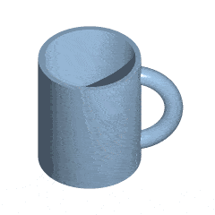
Topology
Connectedness, not shape and size
Penrose’s proof: using topology, doesn’t require that the traped surface must be spherically symmetric
1960s，Penrose, with Hawking, Geroch, and Ellis developed “global” differential geometry
Penrose & Hawking（1970）Singularity theorem
Hawking （1971-72）Area non-decrease theorem

Slide 33
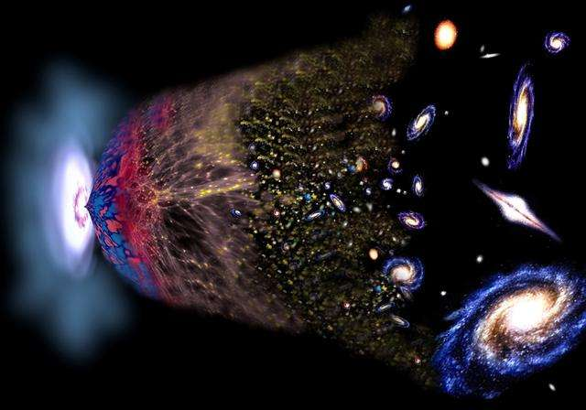
Cosmological singularity (Hawking & Penrose)

Slide 34
Physics near singularity
Resolution by quantum effect？
Physical d.o.f. near singularity?
What is quantum gravity？
Spin foam?
Spin network?
Quantum Cosmology
Bounce universe?
String theory：
Pre-big-bang phase?
Eternal cyclic model?
Braneworld?
Matrix model?
Noncommutative geometry？
Emergent spacetime?
……

Slide 35
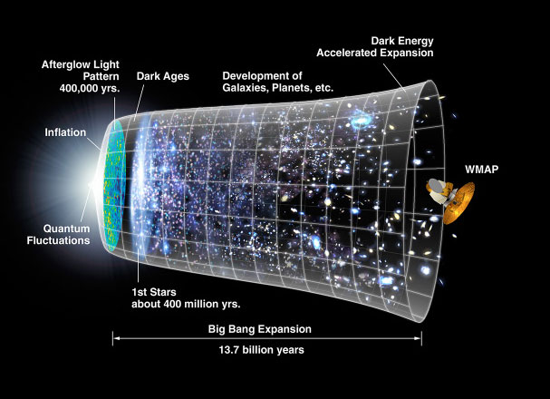
Very early universe
Significant quantum gravity effect，closely relating to the birth and evolution of Universe, the formation of large scale structure, and possibly the nature of dark energy and dark matter

Slide 36



CMB anisotropy
J.C. Mather and G.F. Smoot
2006 Nobel Prize
Quantum fluctuations at the early universe as the seed of large scale structure

Slide 37


Matter components
What is dark energy?
What is dark matter?

Slide 38




Hawking radiation：BH is not black
BH has no hair： J, M, Q
Hawking radiation is thermal

Slide 39


Information loss problem
Pure state becomes mixed state
Entanglement between radiation and its partner inside the horizon

Slide 40



Gravitational wave (2015)

Slide 41


Slide 42


Slide 43


Pulsar-Timing Array

Slide 44


BH area law

Slide 45

BH images
EHT Collaboration Awarded the Breakthrough Prize in Fundamental Physics

Slide 46




Slide 47


Slide 48

How to read spacetime information from pictures?
Physics around BH? Accretion disk, jets, magnetic reconnection,…

Slide 49

Near-horizon Polarization
Frame-dragging effect
A novel way to determine t
the spin of BH
Y.H. Hou et al., Astrophys.J.Lett. 988 (2025) 2, L51

Slide 50

BH：Intriguing object with rich physics

Slide 51

Great questions:
1、Components of the Universe?
5、Can the physical laws be unified?
27、What drives the accelerating
expansion of the Universe?
31、What is the nature of BH?
32、Why matter is more than anti-matter?
33、Does the proton decay?
34、What is the nature of gravity?
35、Why time is different from other dimensions?

Slide 52

BH physics in multi-messenger era

Slide 53
Opportunities and Challenges
Mass spectrum of BH：primordial BH？
Forming mechanism of supermassive BH?
Physics near BH：accretion disk, dark matter, magnetic field, jet?
Neutron star：E.o.S？Quark star, exotic star, …
Particle astrophysics and cosmology：New physics？Neutrinos, Baryon asymmetry, …
Quantum gravity?

Slide 54

Neutron star: E.o.S?
Phase at low T and high chemical potential
One of central questions in nuclear astrophysics
Formation of BH
Multi-messenger astronomy：GW and EM

Slide 55

Primordial BH as DM?

Slide 56

DM around supermassive BH
What is DM?
Axion as DM?
super-radiance
Axion cloud
GW
BH images

Slide 57


AdS/QCD
Strong coupling in QCD: weak coupling in gravity
QGP physics
Various questions in QCD

Slide 58
Thanks for your attention !

Slide 59

黑洞：探测量子引力的窗口！
简单的系统:
M, J, Q
复杂的物理：
黑洞熵
微观统计解释？
霍金辐射：黑体辐射
信息丢失？
黑洞熵满足面积律 =》全息原理

Slide 60



全息原理：量子引力基本原理 （’t Hooft, L.Susskind，1993)
在一个引力系统中，区域V
中的最大熵正比于V的边界
面积（Planck单位），
而非体积。
V中的物理可以通过边界
全息屏上的某个理论来描述
=>黑洞存在全息描述
AdS/CFT 对应是全息原理
最成功的具体实现

Slide 61


AdS/CFT 对应
Anti-de-Sitter 时空中的量子引力理论
与其边界上的共形场论对偶（等价）
（J. Maldacena 1997）

Slide 62

时空的呈展（涌现）：引力的本质？

Slide 63

AdS/CFT: 幺正性保持

Slide 64

C. Herzog’s talk at “AdS/CFT 20 years”

Slide 65


基本问题：
引力/规范对应的普适性？
如何建立一个引力的全息描述？
非AdS引力：宇宙的全息描述？
引力和时空的本质：涌现现象？
什么样的量子场论有引力的描述？
。。。。。。
如何建立更加准确的对应关系来描述实验现象？
深入理解引力的全息性
Notes:
尽管引力/规范对应的研究取得了很大的进展（12000+），其影响扩展到了物理学的很多领域，但这个对应关系本身存在着一些基本问题亟待解决。在理论上，我们希望更好地 理解引力/规范对应的普适性问题，比如说，对于一个一般的引力系统，如何建立它的全息描述？对于非AdS的时空，如我们的宇宙，它具有暗能量，可以看作是具有一个正的宇宙学常数，是渐近dS，它们的全息描述是什么？AdS/CFT说明量子引力可以通过对偶的场论来定义，这让我们重新思考引力和时空的本质，它们是否是基本的，还是只是一种呈展现象？对于量子场论而言，什么样的量子场论可以有引力的描述，以及如何建立更加准确的对应关系来描述实验现象？这些基本问题都需要我们对引力的全息性有更加深入的理解。

Slide 66


It from Qubit? --Simons几何和物理中心
纠缠熵也许是理解引力全息性的关键
纠缠是量子系统的典型特征: EPR
纠缠熵是对纠缠程度的度量
全息纠缠熵 Ryu-Takayanagi (2006)
时空=量子纠缠的比特？
Notes:
近年来的研究发现，纠缠熵也许是理解引力全息性的关键。（美国Simons几何和物理中心资助了该方向的研究）纠缠是量子系统的典型特征，而纠缠熵是对纠缠程度的度量。考虑一个双粒子系统，粒子具有自旋1/2。如果系统的波函数可以分解成两个粒子波函数的直积，说明这两个粒子没有纠缠，纠缠熵为0.而如果这个系统的波函数是EPR态，则这两个粒子互相纠缠，纠缠熵是log2.

Slide 67

神秘的引力
无处不在
只有吸引，没有排斥
长程作用力（类似于电磁力）
最弱的力：星体的形成、星系的形成。。。
引力的量子效应？

Slide 68
AdS/CFT 对应 II
（量子）引力/（共形）场论对应
由于共形场论在最初的版本中是一个规范理论，因此这个对应也常称作引力/规范对应
定义弦理论的全新方式
丰富的物理: 全息原理、规范理论的大N极限、开-闭弦对偶

Slide 69
Einstein等效原理（EEP）
自由下落粒子的行为是普适的，与粒子的质量无关
Einstein：“If a person falls freely, he will not feel his own weight”
EEP：In small enough regions of spacetime, the laws of physics reduce to those of SR; it is impossible to detect the existence of a gravitational field by means of local experiments

Slide 70


引力红移
光子在引力场中频率必然发生改变！

Slide 71
弯曲时空
平坦时空
引力红移的启示：时空不可能是平坦的

Slide 72
AdS/CFT中的信息丢失问题
幺正性如何保持？
如何探索黑洞内部的物理？
……

